Slide 1












France
Cultural Food Project
Melisa Onc
11:709:245:90
12/10/25

Slide 2
Traditional Ingredients & Food
Breads: Baguettes, Brioche, and Croissants
Main Dishes: Ratatouille (vegetables and tomato dish), Bouillabaisse (fish stew), confit de canard, Coq au vin (French braised chicken dish).
Cheeses: Brie, Camembert, and Roquefort
Desserts & Pastries: crème brûlée, éclair, crêpes, macarons, tarte tartin.
Drinks: Champagne & French Wine
École Ducasse. (2023). The History of French Cuisine. École Ducasse. https://www.ecoleducasse.com/en/blog/history-french-cuisine?\

Slide 3
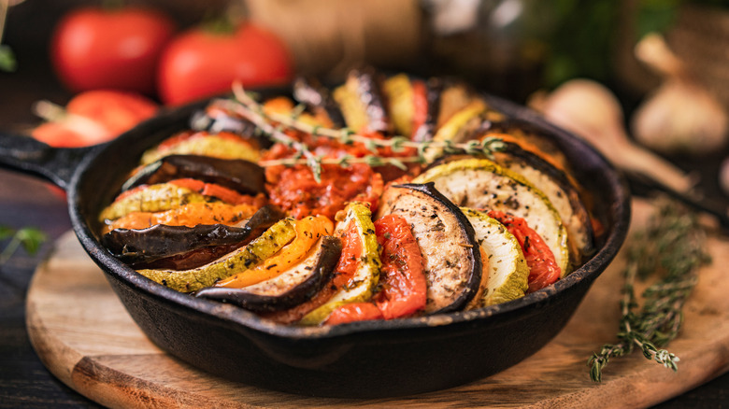
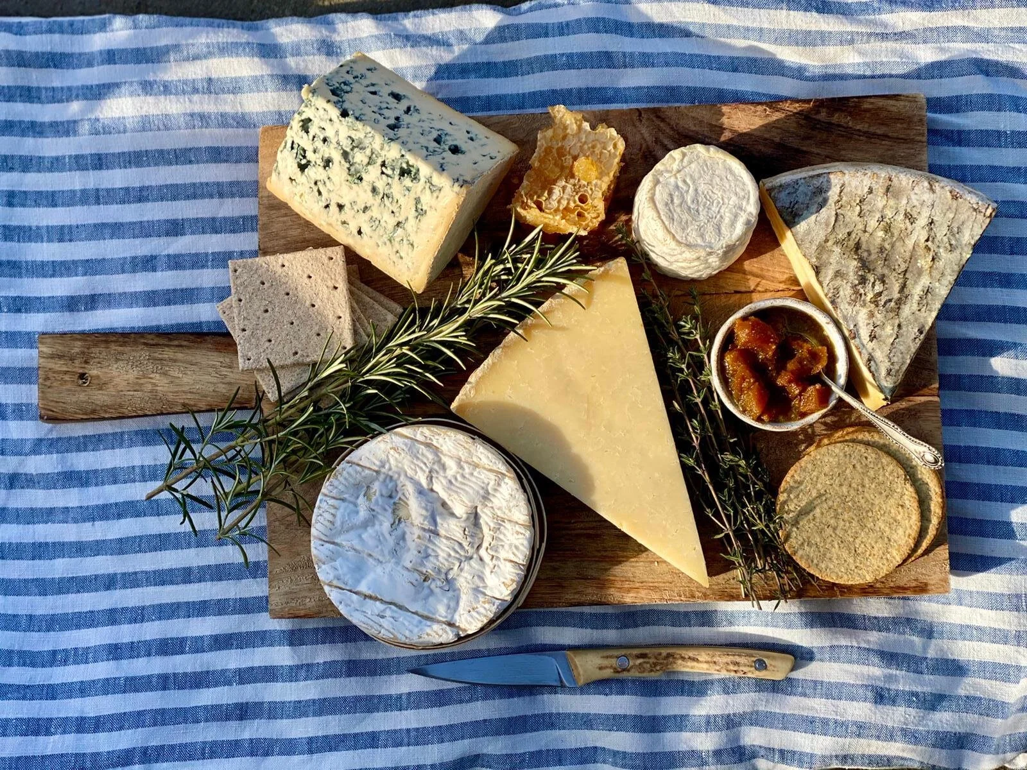
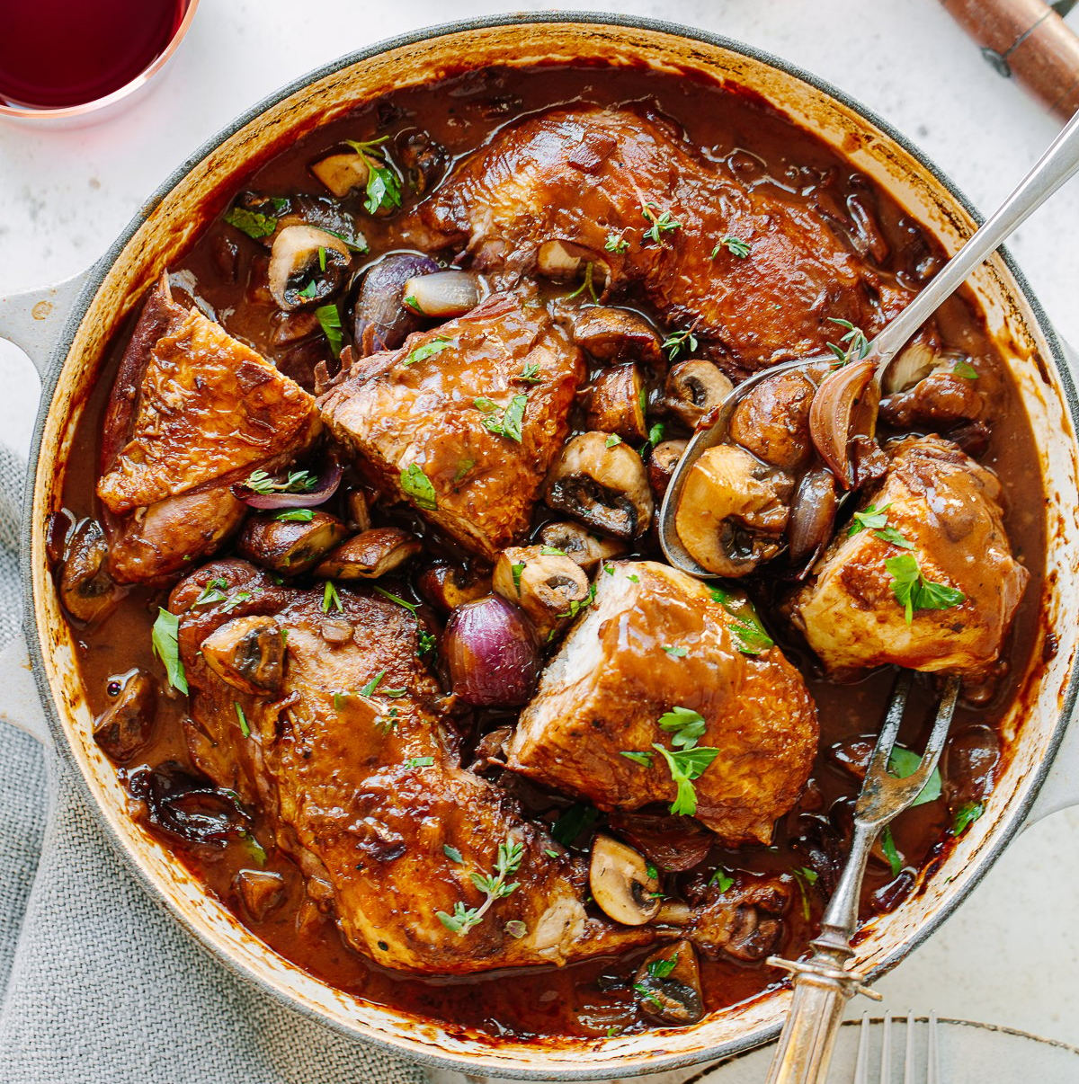

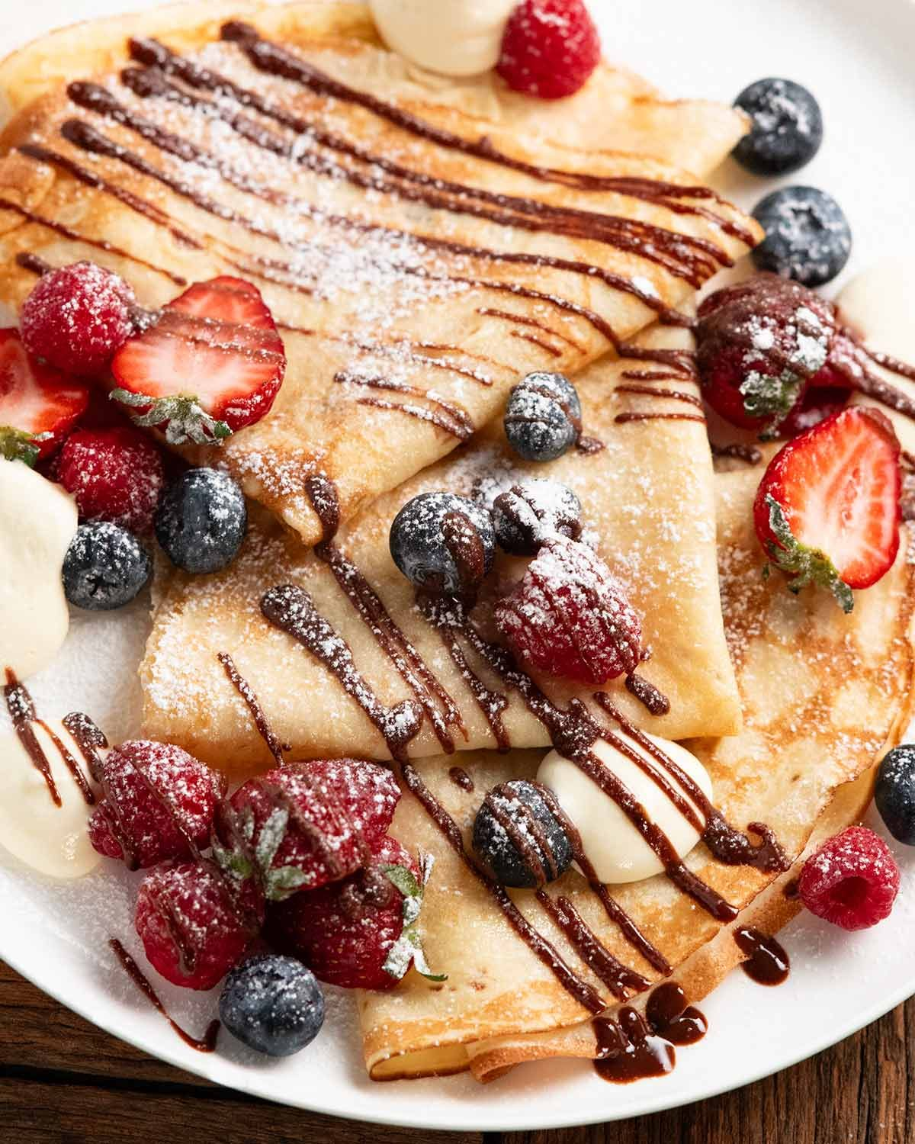
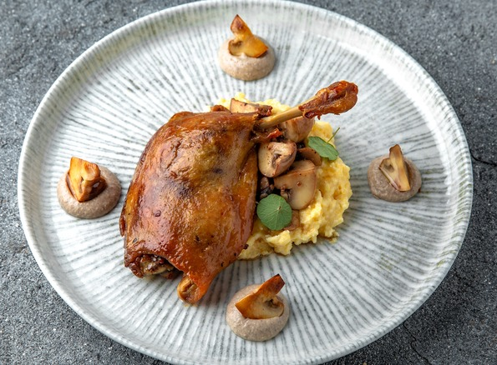
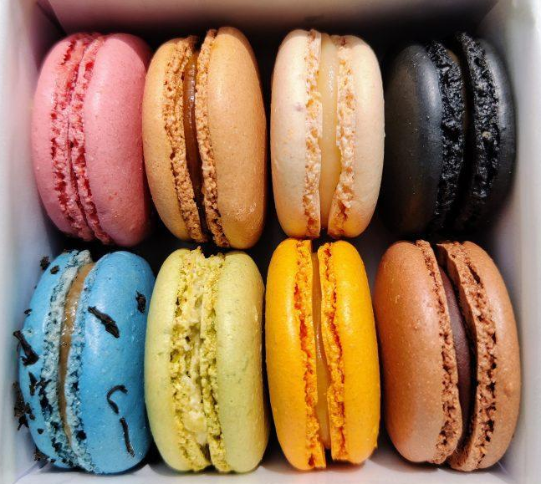
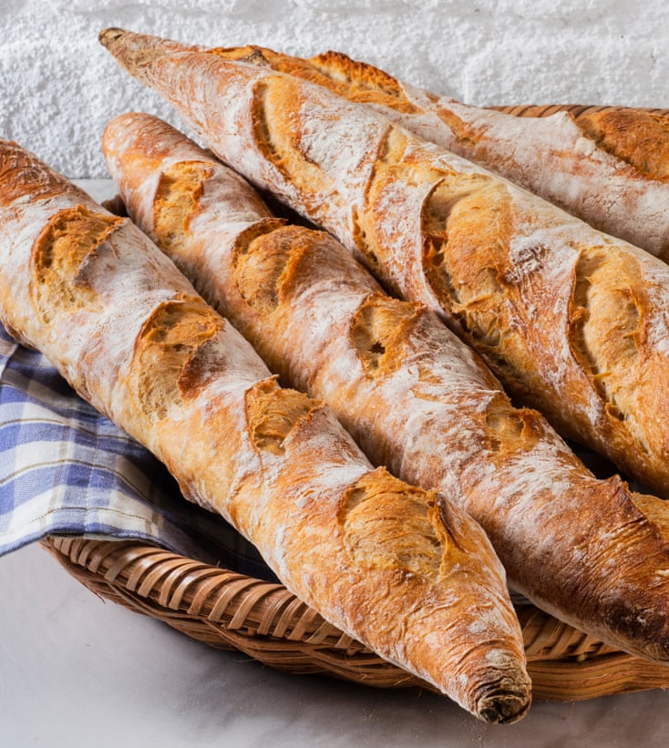
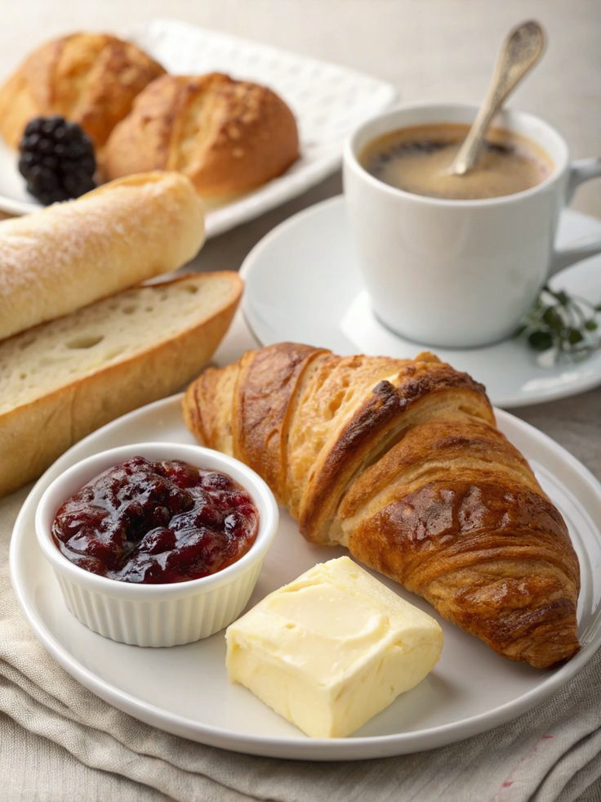
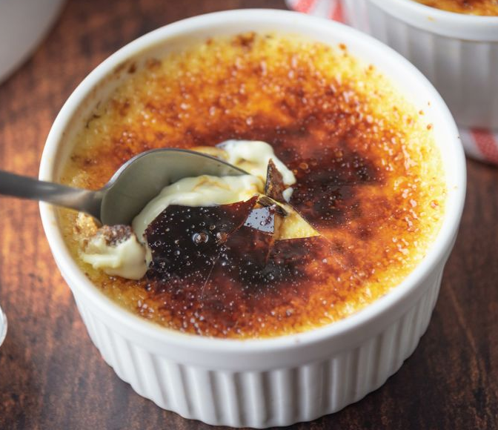
Traditional Ingredients & Food (images)

Slide 4
Meal Patterns
Le petit déjeuner (breakfast): typically, a simple quick meal, such as croissants or bread with butter and jam, sometimes accompanied by eggs or ham. Adults usually drink coffee or tea, while children often have hot chocolate (New World Encyclopedia, n.d.).
Le déjeuner (lunch): historically, along midday meal, the modern work schedules have shortened lunch to about an hour. In small towns, extended family lunches – especially on Sundays – remain common. Many students and employees eat at school or workplace cafeteria, while other others choose bakery sandwiches or return home (New World Encyclopedia, n.d.).
Le dîner (dinner): evening meal shared with family, also a multi-course structure. Begins with hors d’oeuvre or soup followed by a main dish consisting of a meat with vegetables, and rice/pasta. Sometimes a salad is offered, and then the meal ends with either a cheese course with fruit, or a dessert. Sometimes the cheese course may be replaced by yogurt. This meal is generally accompanied by wine, bread, and mineral water. This meal is often served between the hours of 7:30pm – 11pm (New World Encyclopedia, n.d.).
Le goûter (snack): a late afternoon snack typically eaten by children, often pastries, bread with chocolate, or fruit. Adults may have coffee instead. (New World Encyclopedia, n.d.).
Apéritifs: drinks served before meals to stimulate appetite, often paired with small bites (amuse-bouche) like cheese, olives, crackers, or pâté. Common apéritifs include champagne, vermouth, and other dry spirits (Bibard, 2021).
Digestifs: stronger alcoholic beverages served after meals, traditionally believed to aid digestion. Popular options include cognac, fruits brandies, and various liqueurs (Bibard, 2021).

Slide 5
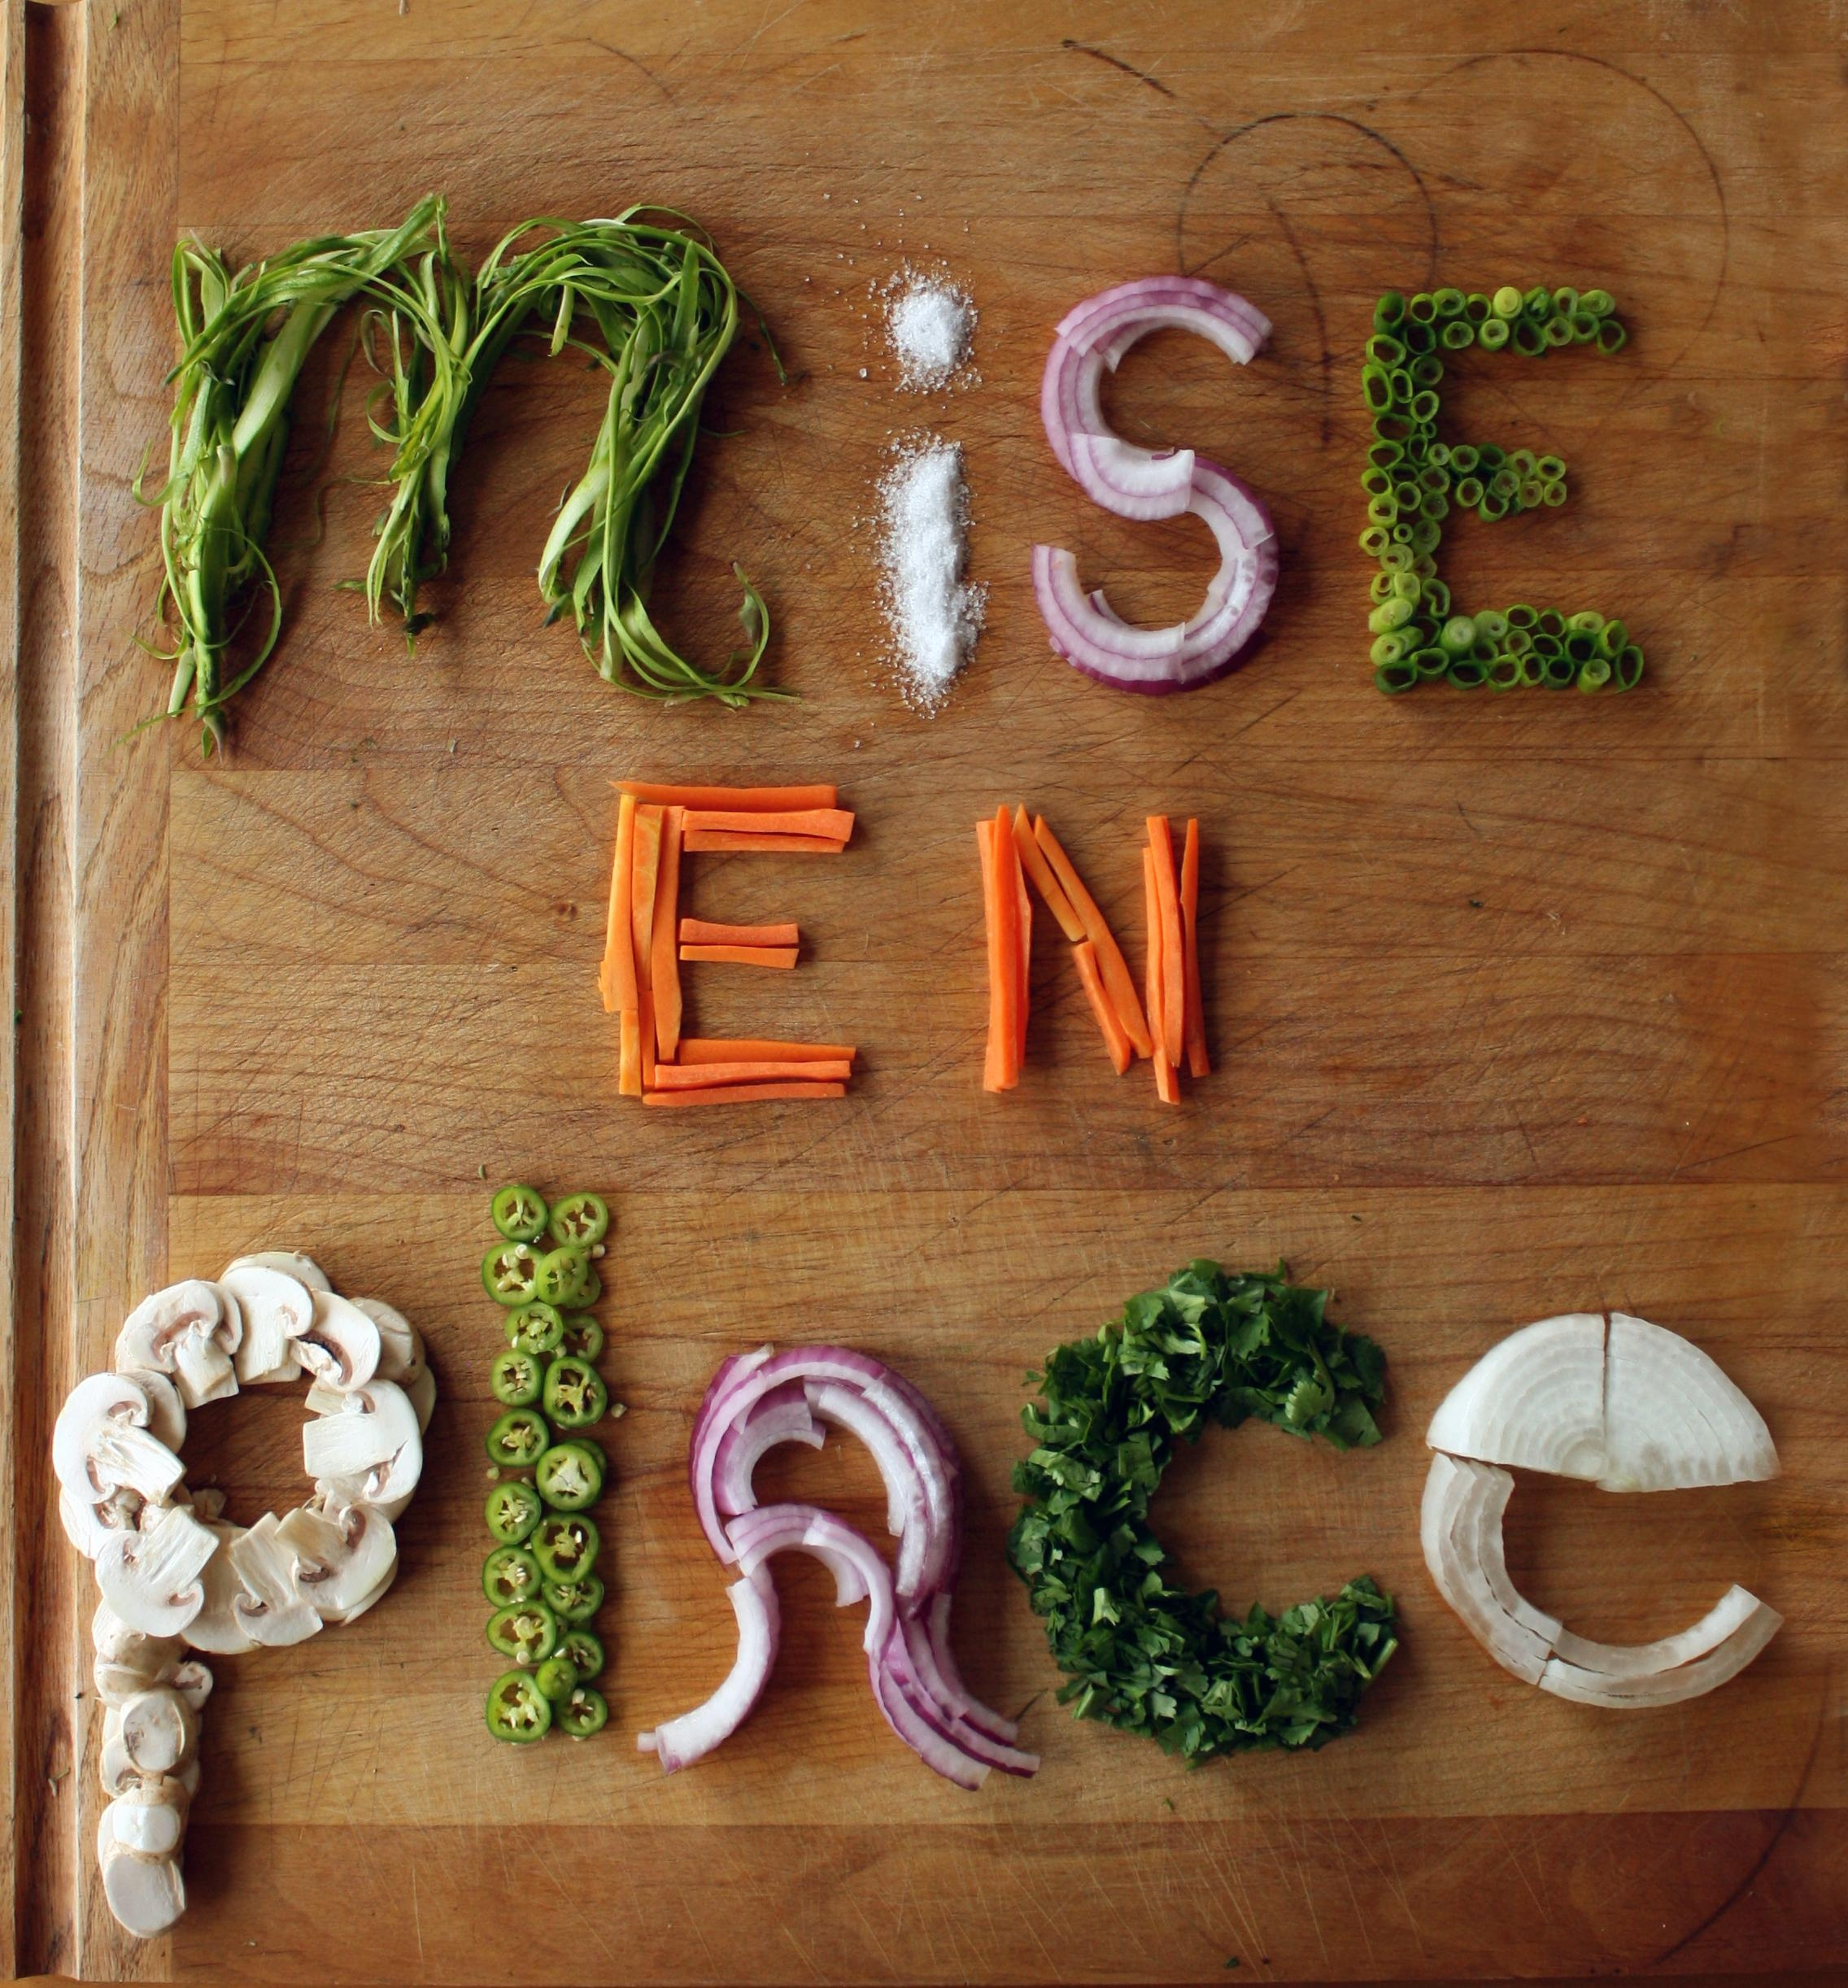
Food Prep Methods
Mirepoix: a base of sautéed onions, celery and carrots used to build flavor in soups, stews, and sauces.
En papillote: cooking food in a sealed parchment pouch, allowing it to steam in its own juices with added herbs or aromatics.
Déglacer: adding wine, stock, or water to a hot pan to release browned bits, creating the base for many sauces.
Sous vide: vacuum-sealed cooking in a precisely controlled water to maintain tendered and moisture.
Flambé: igniting alcohol like cognac or rum to impart caramelized flavor and dramatic presentation.
Payne, Laura (n.d.) French Cuisine. Britannica. https://www.britannica.com/topic/French-cuisine

Slide 6
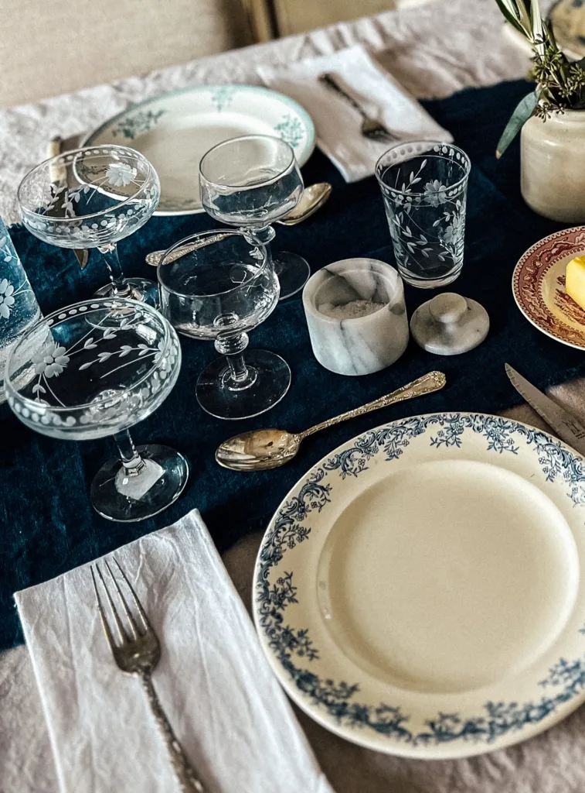
Cultural Influence
Historically: French food culture emphasized formal meals, strict table etiquette, long family lunches, regional traditions, and wine served daily. Meals were generally slow, savored, ritualized, and deeply tied to an individuals’ cultural identity. (UNESCO; Fischler, 1988)
Modern-day: Although art de vivre and their appreciation for having quality food remains, the modern life has shortened lunch breaks to only 1 hour, when usually it was at least 2 hours. It has also made café culture and casual dining more common. But regardless, individuals still value fresh, seasonal foods, but with more flexibility and multicultural influence (Rampont, 2025).
Influence: Strong cultural identity around cuisines encourage traditional dishes, seasonal produce, and multicourse meals. The shift toward a faster lifestyle has increased consumption of bakery sandwiches, café meals, and simpler everyday foods.

Slide 7
Demographics
Population
  68.4 million (2024) → 49% male, 51% female
Age
  0-14 (17.3%) ; 15-64 (60.7%) ; 65+ (22%)
Obesity Rate: 21.6%
Religions
  Roman Catholic 47%, Muslim 4%, Protestant 2%, Buddhist 2%, Orthodox 1%, Jewish 1%, other 1%, none 33%, unspecified 9%
Ethnic groups
  Celtic and Latin with Teutonic, Slavic, North African (Algerian, Moroccan, Tunisian), Indochinese, Basque minorities
Central Intelligence Agency. (2023). The World Factbook: France. https://www.cia.gov/the-world-factbook/countries/france/
Population size → increased food production demands
Age distribution → can influence food market, meal programs, and diet trends
Obesity Rates → reflects shifts towards more processed foods and changing lifestyle patterns
Religious percentages → can influence fasting patterns, ingredient restrictions, and holiday foods that are served. (i.e. halal)
Cultural/Ethnic diversity → affects acculturation and globalization of food trends.

Slide 8
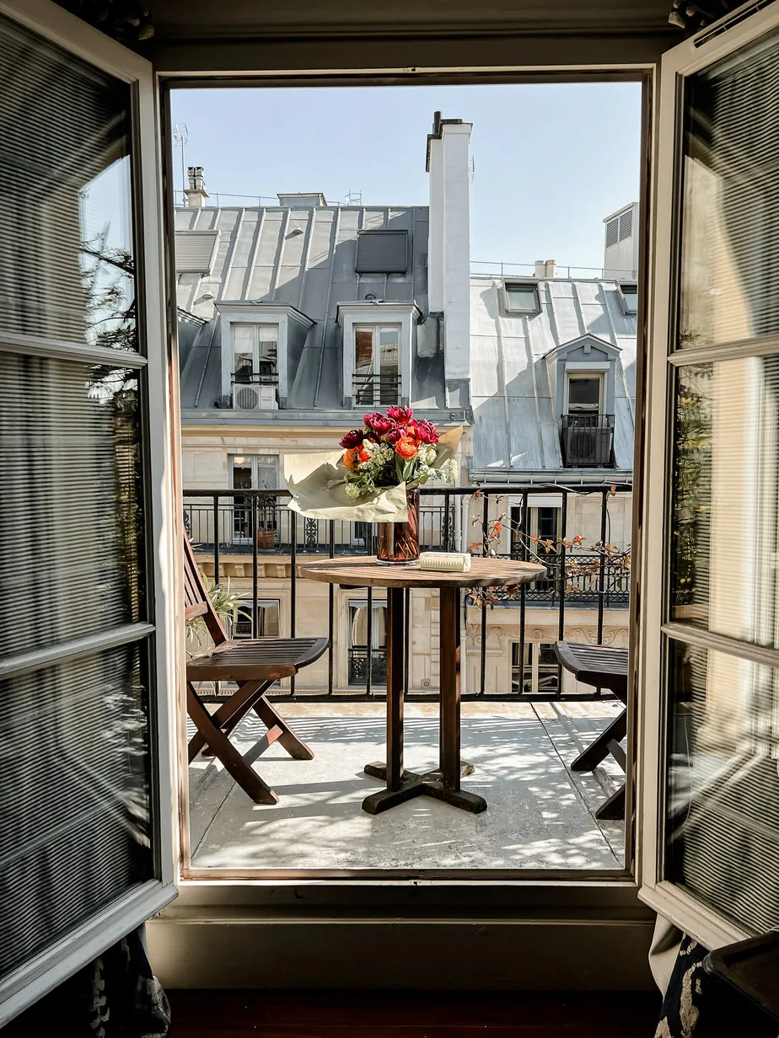
Social Structure
Historically: Most families ate at home, with long midday meals and a strong routine shared family eating. Children often returned home for lunch and meals were centered around homemade meals with their caregivers (Fischler, 1988).
Modern-day: Shorter work and school lunch breaks mean many adults and students now eat at cafeterias, corporate canteens, or rely on bakery sandwiches instead of going home to eat (Bibard, 2021).
Shift in family routines: While dinner remains important for family connections, weekday meals are quicker and more simple due to modern-day schedules and dual income households – with the mother (historically the caregiver) now working as well (Rampont, 2025).
Impact on food choices: these structural changes have increased the consumption of processed foods and ready-made meals from cafés during the week due to busier schedules. But traditional multicourse meals are still utilized on weekends and special occasions.

Slide 9

Economy
Historically: economic conditions strongly shaped French food availability. During World War II, rationing and shortages – especially of animal proteins – led households and chefs to prepare simpler, lighter dishes. These constraints later influenced the development of nouvelle cuisine. As economic conditions improved, in the postwar decades, chefs gradually returned to richer “Haute Cuisine” while retaining some lighter techniques introduced during wartime. (New World Encyclopedia, n.d.)
Modern-Day: France’s high-income economy provides broad access to diverse foods, yet economic pressures continue to influence purchasing habits. The country has a current inflation rate of 2%, but food prices have risen faster than the general inflation, which influences consumer choices when it comes to food (CIA, n.d.). Approximately 15.6% of the population currently lives below the poverty line, and 7.4% are unemployed (CIA, n.d.). This means some households rely more on affordable supermarket options – like packaged and ready-made foods. About 12.6% of the household expenditure are spent on food, highlighting both the cultural importance and budget constraints of the general population at the moment (INSEE, 2023)
Despite all these shifts, traditional dishes with emphasis on fresh ingredients and multicourse meals remain central in the French culture -- especially during weekends and holidays.

Slide 10

Politics
Government structure and regulation: France’s semi-presidential system provides a stable political environment, allowing consistent government planning and oversight that supports food production/distribution. (BBC, 2024).
Healthcare and consumer protections: France’s universal healthcare system emphasizes public health, which influences government attention to food quality, and consumer protection (International Living, 2025).
EU membership and food standards: As a member of the EU, France follows EU-wide regulations that affect agriculture, labeling, and trade. These policies influence what foods can be produced domestically and what foods are available through imports. (European Union, n.d.).
Regional policy structure: France’s 18 administrative regions operate under national and EU guidelines, helping implement agricultural and food-related policies consistently across the country. (European Union, n.d.).

Slide 11

Geography
Regional diversity: France’s varied landforms create distinct food regions. Coastal areas along the Atlantic and Mediterranean support diets rich in seafood and saltwater fish (Britannica, 2024).
Northern & Western farmlands: Poitou and Charente have fertile pastures that support dairy production (like butter, cream, cheese) and Normandy is known for the apple orchards which are responsible for many apple-based dishes (New World Encyclopedia, n.d.).
Central regions: Burgundy’s plains and river valleys are ideal for cattle raising and wine production, shaping dishes like Boeuf Bourguignon (New World Encyclopedia, n.d.)
Southern France: Provence’s Mediterranean landscape supports olives, tomatoes, garlic, and herbs – which define regional cuisine (Payne, 2024).
Eastern border regions: Alsace’s location near Germany contributes to hearty foods like sauerkraut and sausages (New World Encyclopedia, n.d.)

Slide 12
Climate
Temperate climate: Most of France experiences mild temperatures and regular rainfall, which supports staple agriculture products like wheat, apples, dairy, and wine grapes (Central Intelligence Agency, 2023). These climate conditions contribute to classic French products like bread, cheeses, and regional wines.
Mediterranean climate (Provence & Southern Coast): hot, dry summers and mild winters in southern France support olives, citrus fruits, herbs, tomatoes, and garlic which play a major role in the lighter herb-heavy cuisines of Provence (New World Encyclopedia, n.d.; Central Intelligence Agency, 2023).
Mountain climates (Alps & Pyrenees): Cooler alpine climates support grazing livestock, leading to regional specialties like cured meats and mountain cheeses (New World Encyclopedia, n.d.; Central Intelligence Agency, 2023).
Climate variability and impacts: Seasonal weather changes, including rising temperatures and periods of drought, can affect the quality and timing of grape harvests, wheat production, fruit crops, etc. This can affect food availability and regional consumption patterns over time. (New World Encyclopedia, n.d.; Central Intelligence Agency, 2023).

Slide 13

Acculturation
North African immigration introduced new foods: Algerian immigrants brought couscous to France during World War I, and it later became one of the most popular dishes nationwide (Grigorova & Dimitrova, n.d.).
Integration into everyday eating: Pari’s first takeout restaurant served couscous, reflecting how immigrant cuisines were integrated into French food culture (Grigorova & Dimitrova, n.d.).
Maghreb pastries in French bakeries: French bakeries increasingly sell North African pastries alongside traditional items, as immigrant food traditions meet growing consumer demand (Grigorova & Dimitrova, n.d.).

Slide 14

Globalization
Exports: $1.071 trillion (Central Intelligence Agency, 2023).
Export partners:
  Germany 11%, Italy 9%, USA 8%, Belgium 8%, Spain 7% (Central Intelligence Agency, 2023).
Imports: $1.074 trillion (Central Intelligence Agency, 2023).
Import partners:
  Germany 15%, Belgium 11%, Netherlands 9%, Spain 8%, Italy 8% (Central Intelligence Agency, 2023).
Global trade expands food access and food variety
Consumer trends shape global markets:
  French consumers show rising interest in international flavors, plant-based items, and ready-to-eat products. This reflects growing food trend. (Innova Market Insights, 2024).
Supermarkets reflect globalization

Slide 15
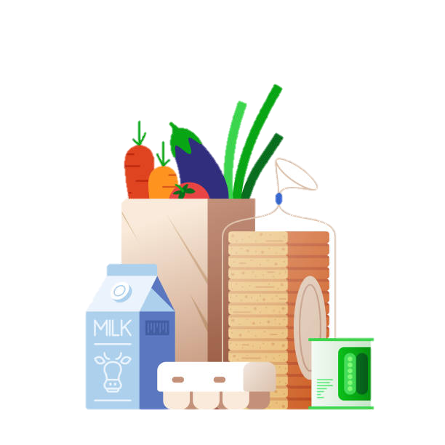
Food Security Programs
The 4 Pillars of France’s definition of
Food & Nutrition Security:
Physical, economic and social access to food
Availability of food
Sanitary and nutritional quality of products
Regular access, availability, and quality
Strong national food security performance: France ranks among the highest globally for food affordability, availability, and safety due to government regulation and social support systems (Economist Impact, 2022).
Programs supporting vulnerable populations: France maintains food-assistance programs like subsidized school meals, emergency food aid, and partnerships with major food-bank networks (OECD, 2022).
Focus on nutrition equity: Policies emphasize improving access to nutritious, safe foods and reducing disparities across socioeconomic groups (Economist Impact, 2022).
Resilience to shocks: France’s food system benefits from stable infrastructure, diversified supply chains, and national preparedness plans that protect food access during economic or climate-related disruptions (OECD, 2022).
France Diplomacy. (n.d.). Understanding food security and nutrition issues. Permanent Representation of France to the United Nations in Rome. https://onu-rome.delegfrance.org/Understanding-food-security-and-nutrition-issues

Slide 16

Nutrient Contributions of Staple Foods
Breads & Cereals (wheat-based) → B-vitamins, fiber (if whole grain version), moderate protein, energy
Dairy products (cheese, yogurt, butter) → calcium, protein vitamin B12 , healthy fats
Meat (beef, poultry, pork) → protein, iron, zinc, B-vitamins
Potatoes → carbs, potassium, vitamin C, fiber
Wine grapes (as wine) → polyphenols and antioxidants like resveratrol
Fruits → vitamin C, fiber, antioxidants
Vegetables (leeks, onions, carrots, garlic) → fiber, vitamin A & C, and a variety of phytonutrients
Seafood → Protein, omega-3 fatty acids, vitamin D
Olives & Olive Oil → monosaturated fats and vitamin E

Slide 17
References
BBC. (2024). France Country Profile. BBC. https://www.bbc.com/news/world-europe-17298730
Bibard, F. (2021). A Guide to French Food Habits. Talk in French. https://www.talkinfrench.com/guide-french-food-habits
Central Intelligence Agency. (2023). The World Factbook: France. https://www.cia.gov/the-world-factbook/countries/france/
École Ducasse. (2023). The History of French Cuisine. École Ducasse. https://www.ecoleducasse.com/en/blog/history-french-cuisine?\
Economist Impact. (2022). Global Food Security Index: France country report. https://impact.economist.com/sustainability/project/food-security-index/resources/Economist_Impact_GFSI_2022_France_country_report_Sep_2022.pdf
European Union. (n.d.). France. European Union. https://european-union.europa.eu/principles-countries-history/eu-countries/france_en
Fischler, C. (1988). Food, self and identity. Social Science Information, 27(2), 275-292. https://doi.org/10.1177/053901888027002005 (Original work published 1988)
France Diplomacy. (n.d.). Understanding food security and nutrition issues. Permanent Representation of France to the United Nations in Rome. https://onu-rome.delegfrance.org/Understanding-food-security-and-nutrition-issues
Giner, C., & Placzek, M. (2022). Food insecurity and food assistance programmes across OECD countries. OECD. https://www.oecd.org/content/dam/oecd/en/publications/reports/2022/09/food-insecurity-and-food-assistance-programmes-across-oecd-countries_2e3fe549/42b4a7fa-en.pdf

Slide 18
References
Grigorova, E., & Dimitrova, D. (n.d.). Food culture in Great Britain and France. Konstantin Preslavsky University of Shumen. https://www.researchgate.net/publication/323736230_FOOD_CULTURE_IN_GREAT_BRITAIN_AND_FRANCE
Innova Market Insights. (2024). Food trends in France: Consumer insights and preferences. https://www.innovamarketinsights.com/trends/food-trends-in-france-consumer-insights-and-preferences/
INSEE. (2023). Institut national de la statistique et des études économiques. (2023). Household consumption expenditures. https://www.insee.fr/fr/accueil
International Living. (2025). Healthcare in France. International Living. https://internationalliving.com/countries/france/health/
New World Encyclopedia. (n.d.). French cuisine. https://www.newworldencyclopedia.org/entry/French_cuisine?
Payne, Laura. (n.d.) French Cuisine. Britannica. https://www.britannica.com/topic/French-cuisine
Rampont, T. (2025). Living in France in 2025: Enjoy the Best of "Old World" Living. International Living. https://internationalliving.com/countries/france/live/
UNESCO. (n.d.). Gastronomic meal of the French. UNESCO. https://ich.unesco.org/en/RL/gastronomic-meal-of-the-french-00437

