Slide 1

Food Trends: influence on purchasing decision & health
Melisa Onc
Independent Study – 489
Dr. Rao
28 November 2025

Slide 2
Trend: Lower Sugar in Foods
Target population:
  Students, working adults, and individuals looking for healthy food without compromising quality/flavor
  Population primarily focused on are individuals who suffer from obesity, CVD, and diabetes⁴
75% of US Consumers support a policy to reduce the amount of added sugar in the food supply¹, including:
  83% of consumers who are trying to reduce their sugar intake¹
  80% of consumers with children in their household ¹
  79% of consumers with high blood pressure, diabetes, high cholesterol, heart disease, or cancer¹
  70% of Republicans, 83% of Democrats, 73% of Independents¹
Potential benefits:
  Reduced risk of CVD events, CVD deaths, diabetes, obesity, healthcare costs ⁴
  Better blood sugar regulation, reduction in daily sugar intake from processed food ⁴
1. (Center for Science in the Public Interest [CSPI], n.d.)
4. (Shangguan et al., 2021)

Slide 3
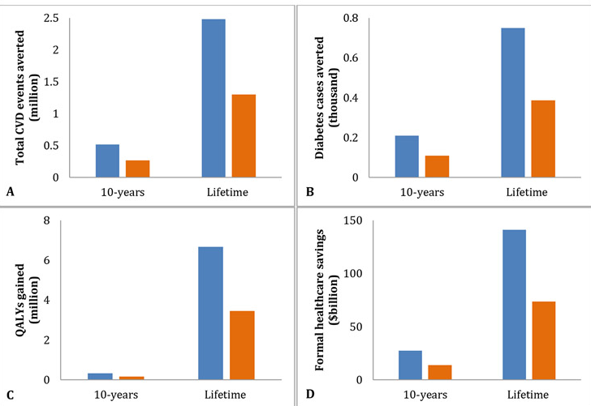
Projected Savings of the Lower Sugar “Trend” ⁴
“Estimated reductions in total CVD events and diabetes cases, gains in quality-adjusted life-years (QALYs), formal health care savings, and net savings from a health care perspective and a societal perspective of the US National Salt and Sugar Reduction Initiative voluntary sugar reformulation policy in US adults over 10 years and lifetime” ⁴
4. (Shangguan et al., 2021)

Slide 4
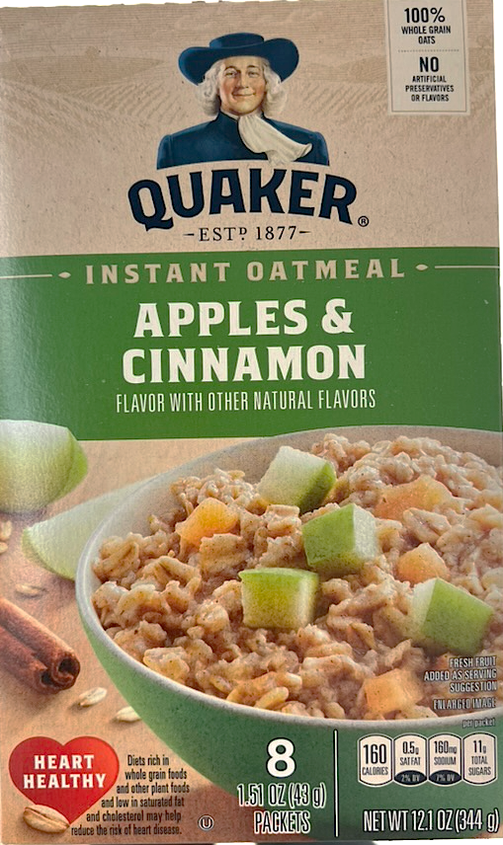
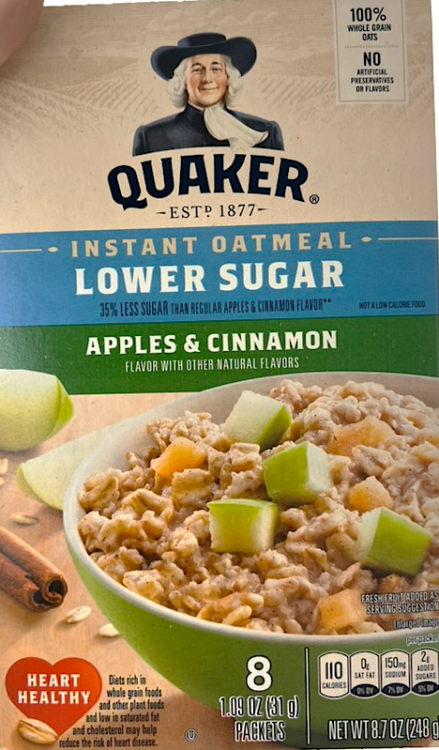
Regular vs. Lower Sugar

Slide 5
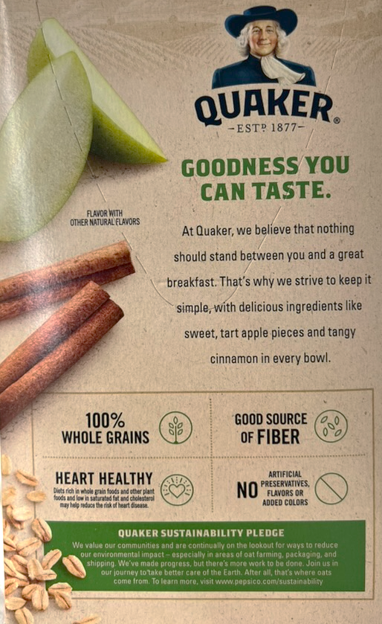
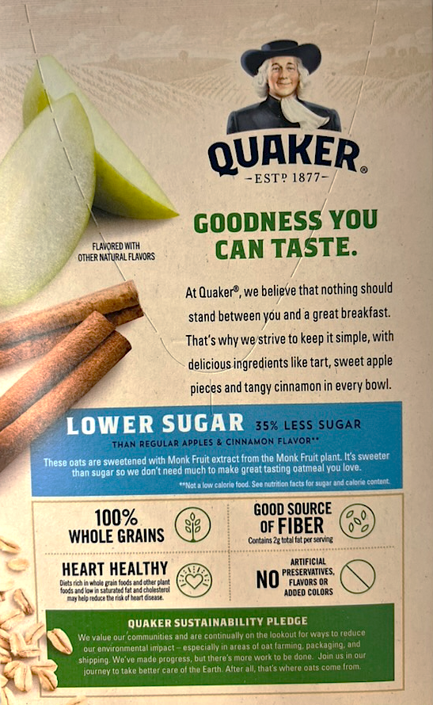
Regular vs. Lower Sugar

Slide 6
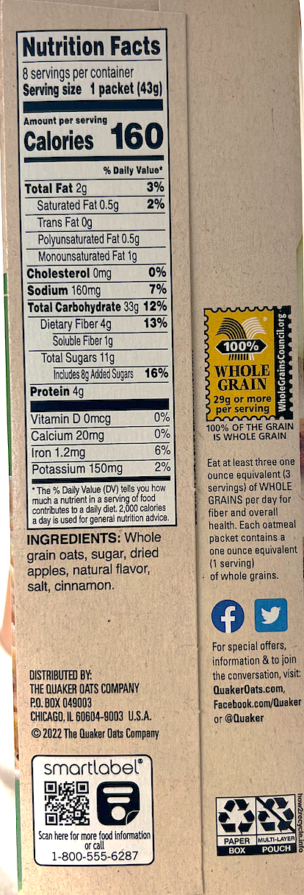
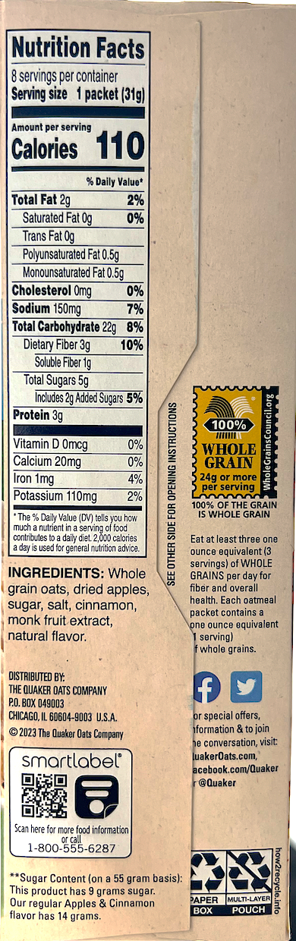
Regular
Lower Sugar

Slide 7
Why is this important?
Overconsumption of foods or beverages high in added sugars is linked to an increased risk of type 2 diabetes and cardiovascular disease, in part by increasing the risk of weight gain, and can contribute to dental decay. ¹
It is becoming more evident that preventative measures must be taken mitigate this. It starts with industry leaders since most of the intake stems from either convenient ready-made food or restaurants.
One of the solutions is to reduce daily sugar intake, through choosing whole foods or products with lower sugar alternatives.
1. (Center for Science in the Public Interest [CSPI], n.d.)

Slide 8
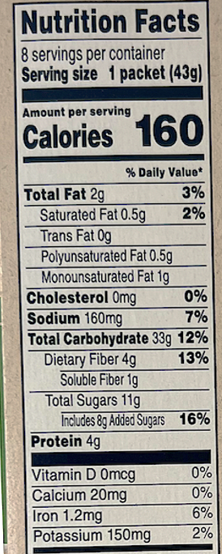
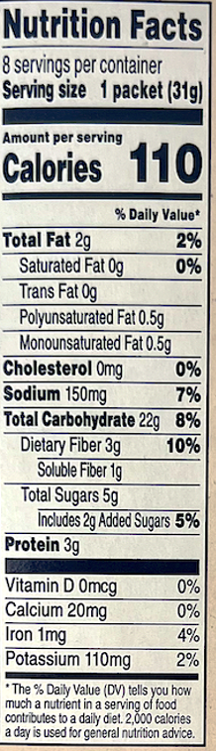

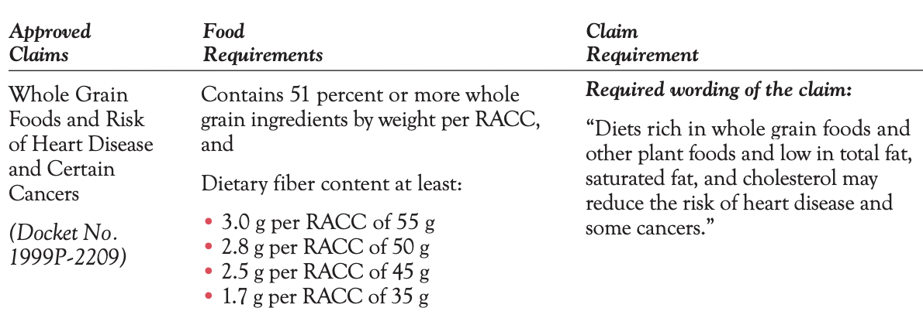
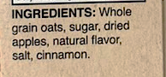
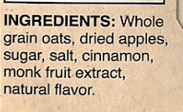
Comparing Ingredients
Structure/Function claim:
  heart healthy
Health claim:
  Diets rich in whole grain foods and low in saturated fat and cholesterol may help reduce the risk of heart disease
Less added sugar → it is listed after the apples on the alternative
Less natural flavor → listed as the last ingredient on the alternative
Monk-fruit extract is the additive
Original
Lower Sugar

Slide 9
Additive – Monk Fruit Extract
Monk fruit extracts are prepared by extracting the water of the fruit of Siraitia grosvenorii. The main components of this fruit are Cucurbitane glycosides²
→ Most of them taste sweet, so they are collectively called mogrosides. ²
→ Mogrosides are present in the fresh fruit (0.55–0.65%). Mogroside V being the main mogroside in the Monk fruit extract.²
Human Clinical study results:
No effect on blood glucose or liver enzymes^{2,3}
No adverse effects were reported in the clinical studies ^{2,3}
Mogroside V is absorbed to some extent and is systemically bioavailable^{2,3}
→ study compared ingestion of sucrose vs. monk fruit extract. Sucrose increased blood glucose by 70% and went down to starting level after 3 hours. Monk Fruit extract had no effect.²
Animal study results:
No side effects ³
No maternal/fetal effects³
No parental, reproductive or developmental toxicity.³
2. (EFSA Panel on Food Additives and Flavourings [FAF], 2019)
3. (Kaim & Labus, 2025)

Slide 10
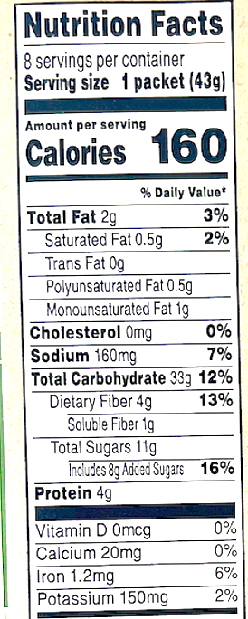
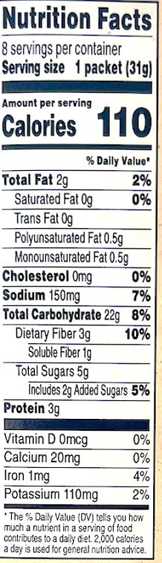
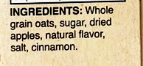
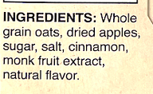
Nutrient Claims
Nutrient Content Claims:
  35% less sugar than regular apple & cinnamon flavor
  → see next slide for review
  good source of fiber
  → must be 10-19% of DV → original had 13%, alternative had 10%
  made with 100% whole grains
  → ingredient list says whole grain oats on both products
  no artificial preservatives or flavors
  → only used “natural flavors” which were indicated on the ingredient list

Slide 11
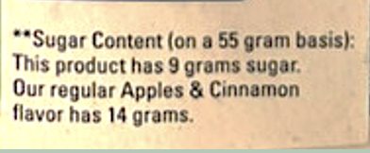
Nutrient Claims (cont.)
The claims are justified.
Based on the Smart Label
Equation: [grams of total sugar] X [55g based on Smart Label] / [Weight of Serving Size in grams]
Original → 11g x [55g ➗ 43g] = 14.07 = about 14g
Alternative → 5g x [55g ➗ 31g] = 8.87 = about 9g
Calculate the Difference:
14g-9g = 6g → now divide by original product’s total sugar (14g) to calculate percent difference
6g ➗ 14g = 0.357 x 100 = 35.7% less sugar than original product
How might consumer interpret these claims, can they be misleading?
  The calculation of 35% less sugar is based on the Smart Label which is calculated based on 55g serving. But the nutrition label is for a 31g serving. So, the numbers do not necessarily match up with the nutrition label, and may be confusing to the customer.
  Regardless it is still lower in sugar when compared to the original.

Slide 12
Would You Recommend This Lower Sugar Trend?
Yes, I would recommend this lower sugar trend to the specific target population. Reason being LNCS can reduce calorie intake, enhance adherence to nutrition recommendations, and assist in weight and glycemic management when substituted for added sugars in an individual’s eating plan⁵. It also does not negatively affect blood glucose levels (H_{A1C} or fasting or postprandial glucose) or insulin regulation in individuals with or without diabetes⁵
Would you recommend this product?
I would not recommend this product for those in the target population that may be experiencing gastrointestinal issues or have sensitive stomach. The monk fruit extract may cause some digestive upset, and they would be better suited making a DIY instant oatmeal without the additives by adding their own fruit, spices, and quick oats.
In terms of the flavor, unfortunately, there was an aftertaste from the monk fruit that wasn’t very pleasant. Based off the reviews online, many individuals who asked for it to be lower sugar meant they wished for it to be less sweet in terms of flavor as well. They would prefer a lower sugar version that didn’t have an aftertaste or required an additive.
5. (Warshaw & Edelman, 2021)

Slide 13
References
A roadmap to lowering added sugars in U.S. foods. (n.d.). https://www.cspi.org/sites/default/files/2023-11/A Roadmap to Lowering Added Sugars in US Foods_10-17-23.pdf
EFSA Panel on Food Additives and Flavourings (FAF), Younes, M., Aquilina, G., Engel, K. H., Fowler, P., Frutos Fernandez, M. J., Fürst, P., Gürtler, R., Gundert-Remy, U., Husøy, T., Mennes, W., Moldeus, P., Oskarsson, A., Shah, R., Waalkens-Berendsen, I., Wölfle, D., Degen, G., Herman, L., Gott, D., Leblanc, J. C., … Castle, L. (2019). Safety of use of Monk fruit extract as a food additive in different food categories. EFSA journal. European Food Safety Authority, 17(12), e05921. https://doi.org/10.2903/j.efsa.2019.5921
Kaim, U., & Labus, K. (2025). Monk Fruit Extract and Sustainable Health: A PRISMA-Guided Systematic Review of Randomized Controlled Trials. Nutrients, 17(9), 1433. https://doi.org/10.3390/nu17091433
Shangguan, S., Mozaffarian, D., Sy, S., Lee, Y., Liu, J., Wilde, P. E., Sharkey, A. L., Dowling, E. A., Marklund, M., Abrahams-Gessel, S., Gaziano, T. A., & Micha, R. (2021). Health Impact and Cost-Effectiveness of Achieving the National Salt and Sugar Reduction Initiative Voluntary Sugar Reduction Targets in the United States: A Microsimulation Study. Circulation, 144(17), 1362–1376. https://doi.org/10.1161/CIRCULATIONAHA.121.053678
Warshaw, H., & Edelman, S. V. (2021). Practical Strategies to Help Reduce Added Sugars Consumption to Support Glycemic and Weight Management Goals. Clinical diabetes : a publication of the American Diabetes Association, 39(1), 45–56. https://doi.org/10.2337/cd20-0034

Slide 14
Any Questions?

