Slide 1

The Effect of Gluten Removal on the
Physical & Sensory Attributes of Chocolate Chip Muffins
Melisa Onc
Independent Study – 489
21 December 2025

Slide 2
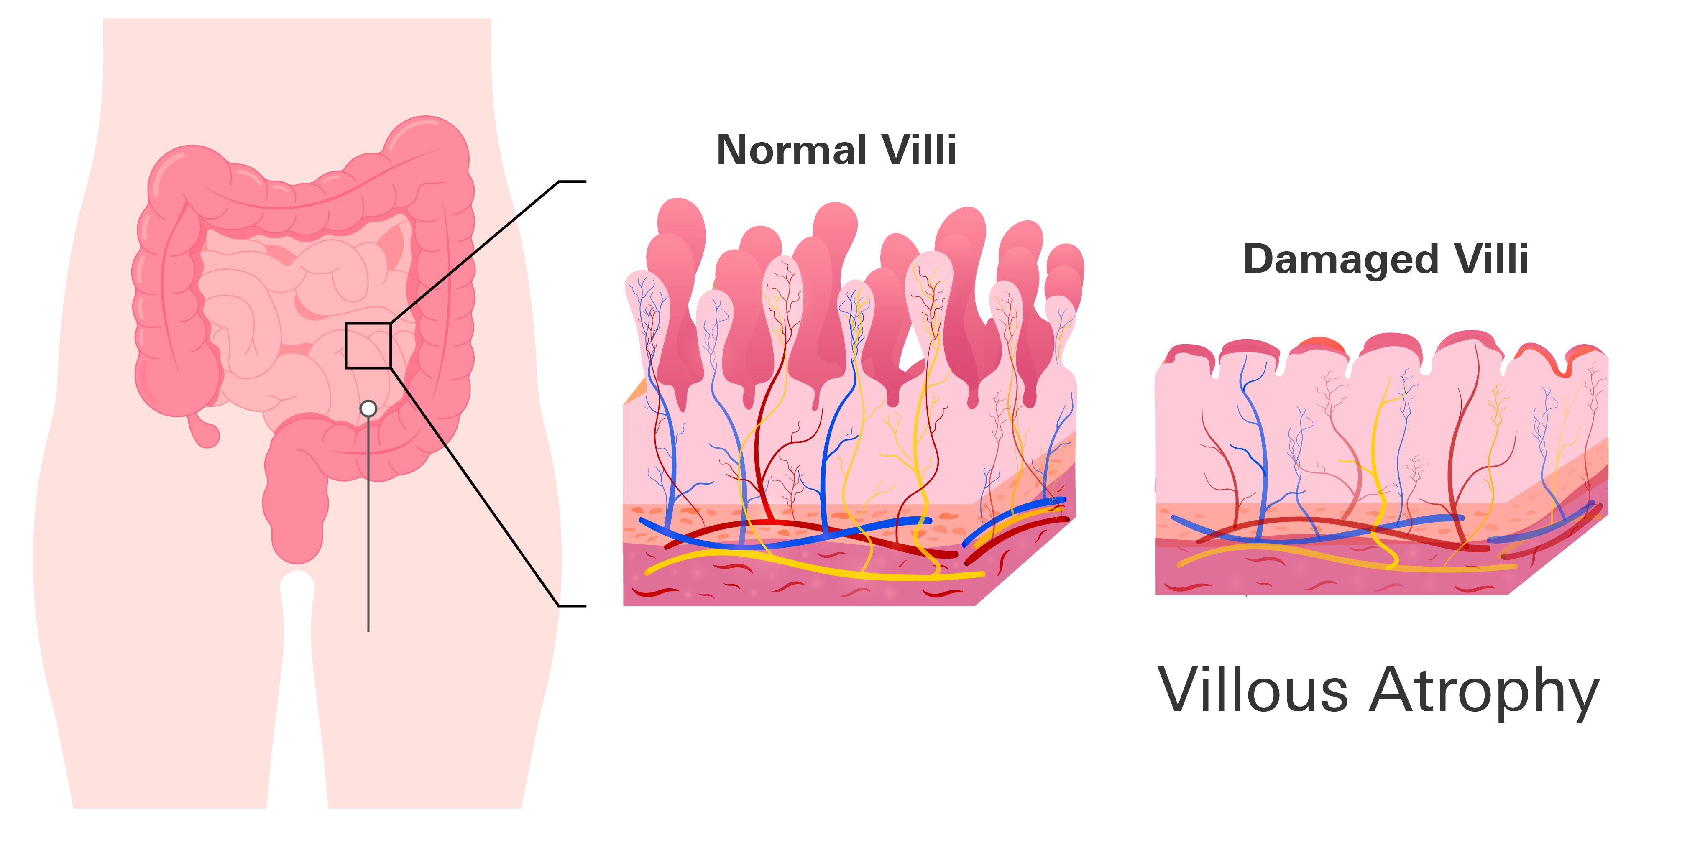
Clinical Condition
(Kowalski et al., 2025a; Celiac Disease Foundation, n.d.)
Celiac disease is a chronic autoimmune disorder triggered by gluten ingestion
Can cause immune-mediated damage to the small intestine (villous atrophy)
Leads to malabsorption and nutrient deficiencies
Requires strict, lifelong elimination of gluten from diet
Even trace amounts of gluten can cause intestinal damage

Slide 3
Clinical Condition – Why is it important?
Affects approximately 1 in 100 individuals worldwide
Largely underdiagnosed → many cases remain untreated
Can develop at any age, with gluten exposure
Untreated celiac disease increases risk of:
  Iron deficiency anemia
  Osteoporosis
  Other chronic health conditions
Diet quality and acceptability of gluten-free products are critical for long term adherence
(Celiac Disease Foundation, n.d.; Kowalski et al., 2025a)

Slide 4

Food Product & Ingredient Replacement
Food Product: Chocolate Chip Muffins
  Quick bread (chemical leavening)
  Batter-based system
  Relies heavily on gluten for structure and gas retention
Ingredient Replaced: All-purpose flour
  Replaced due to gluten-content
Independent Variable: Flour Type
  All-purpose flour (control)
  1-to-1 commercial gluten-free flour
  DIY gluten-free flour blend
  Cassava flour
Relevance: Supports dietary compliance for individuals with celiac disease

Slide 5
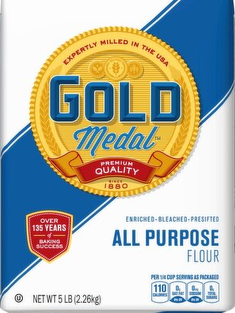
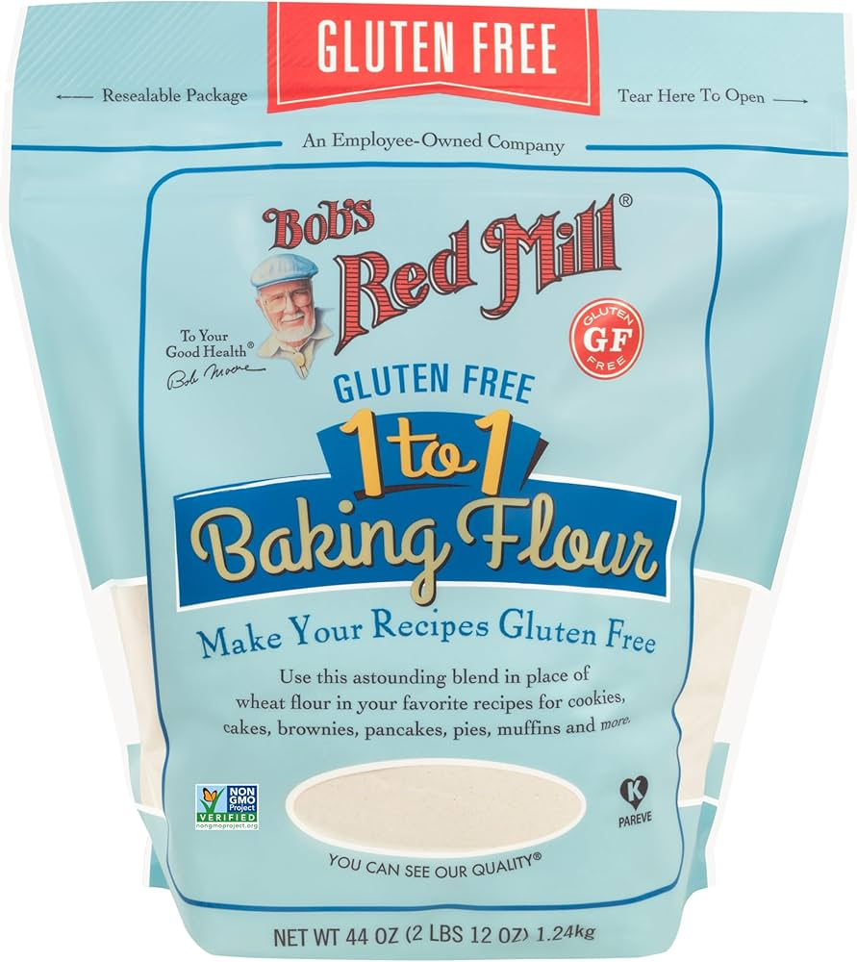
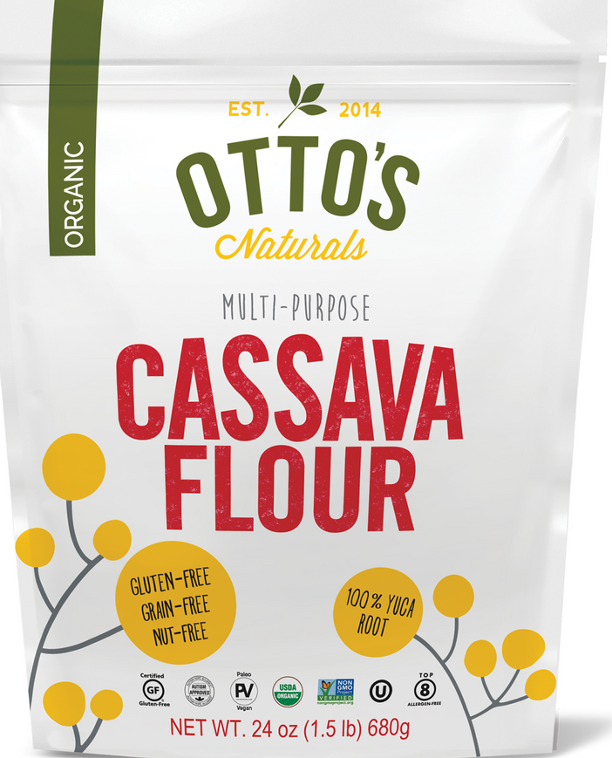
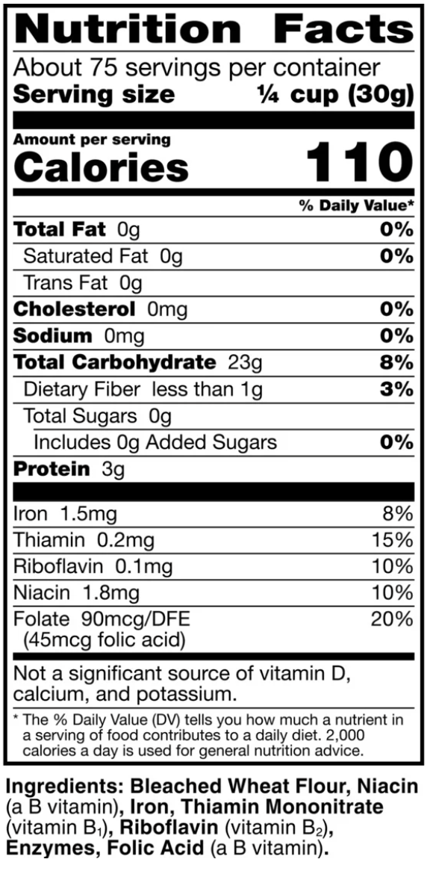
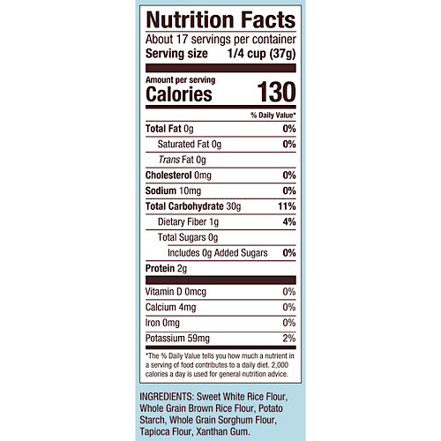
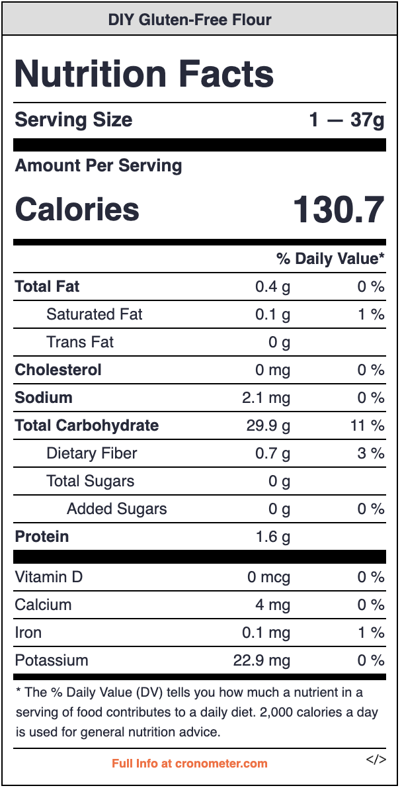
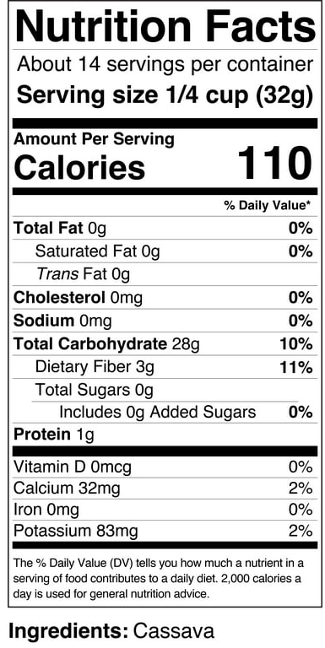
Food Product
DIY Gluten-Free Flour
Ingredients:
White Rice Flour, Potato Starch, Tapioca Flour
(Cronometer, n.d.)

Slide 6
Hypotheses
Nutrition
H_{1:} If gluten-containing flour is replaced with gluten-free flour alternatives, then the nutritional profile of the muffins will differ from the control formulation, because gluten-free flours vary in fiber and micronutrient content compared to all-purpose flour.
Objective
H₂: If muffins are prepared using gluten-free flour alternatives instead of all-purpose flour, then they will exhibit lower overall volume, because the absence of gluten limits gas retention and structural expansion during baking.
H₃: If muffins are prepared using gluten-free flour alternatives instead of all-purpose flour, then they will have reduced height, because gluten provides the structural strength required for vertical rise during baking.

Slide 7
Hypotheses (cont.)
Sensory
H₄: If muffins are prepared using gluten-free flour alternatives instead of all-purpose flour, then they will receive lower overall liking scores, because changes in texture and crumb structure may negatively affect consumer acceptability.
H₅: If muffins are prepared using different gluten-free flour formulations, then perceived sweetness will differ among samples, because variations in starch composition can influence sweetness perception despite identical sugar content.
H₆: If muffins are prepared using gluten-free flours with higher starch content, then they will be perceived as more moist, because alternative starches have greater water-binding capacity than all-purpose flour.
H₇: If muffins are prepared using gluten-free flour alternatives instead of all-purpose flour, then they will be perceived as having greater crumb density, because the absence of gluten reduces crumb elasticity and crumb openness.

Slide 8

Methods: Production Preparation
Standardized chocolate chip muffin recipe
Flour was the only variable altered
4.0 oz flour used
DIY blend: white rice flour, potato starch, tapioca flour
Identical mixing, baking, and cooling conditions

Slide 9
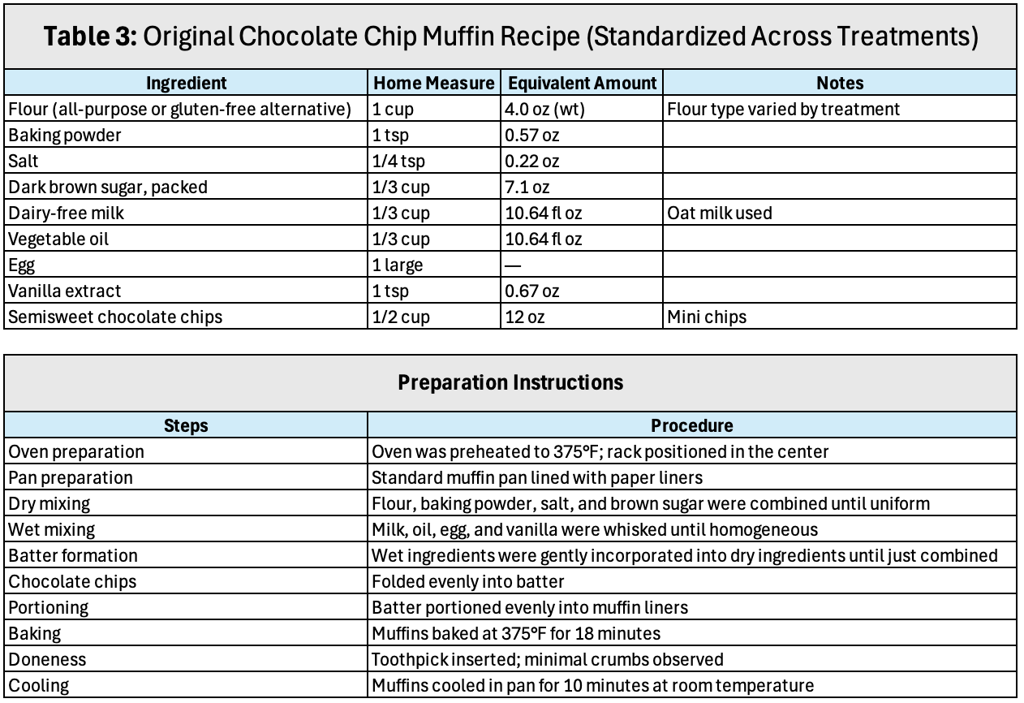
Recipe & Preparation

Slide 10
Evaluation Methods
Objective
Muffin height measured with ruler (mm)
Muffin volume measured via rice displacement (mL)
Measurements averaged per treatment
Sensory
Untrained panel (n = 7)
7-point hedonic scale
Attributes:
  Overall liking
  Sweetness
  Moistness
  Crumb density
Samples labeled with randomized 3-digit codes

Slide 11
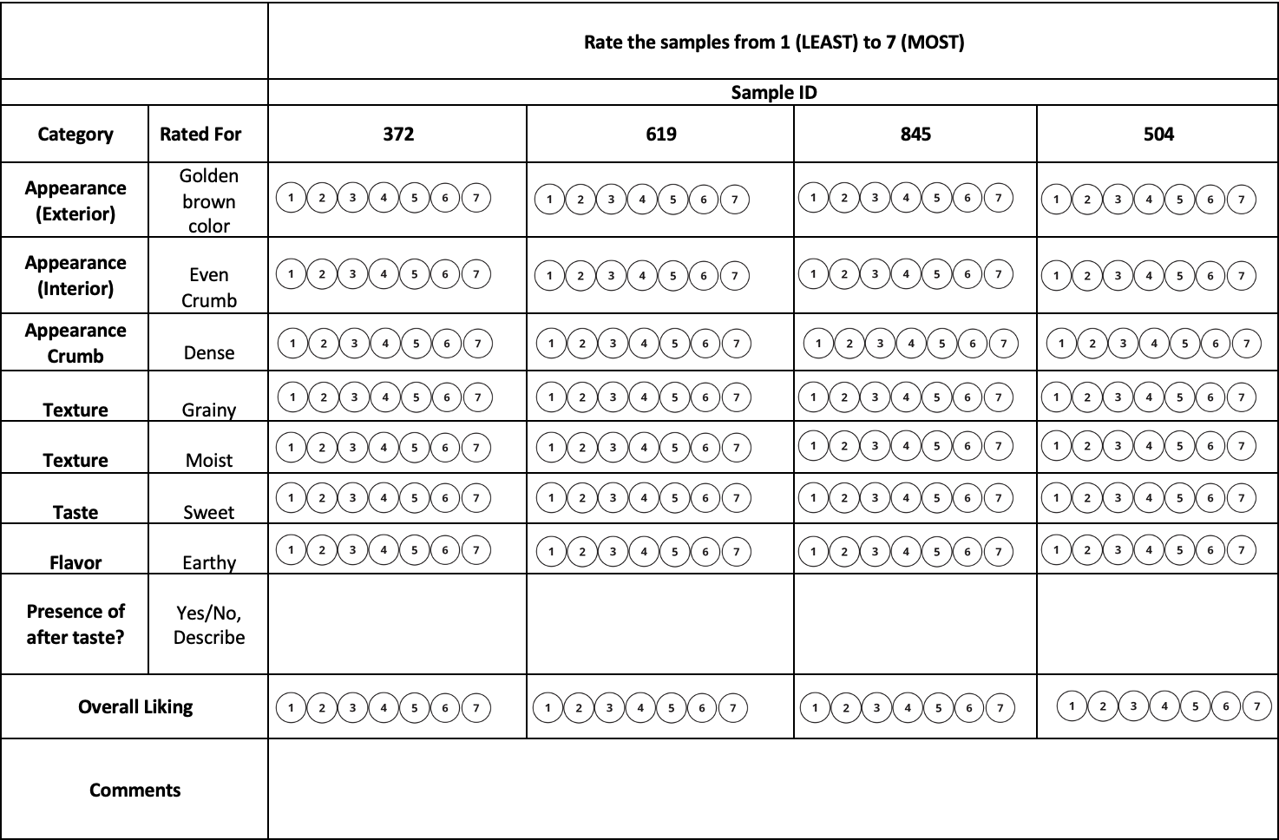
Sensory Ballot

Slide 12
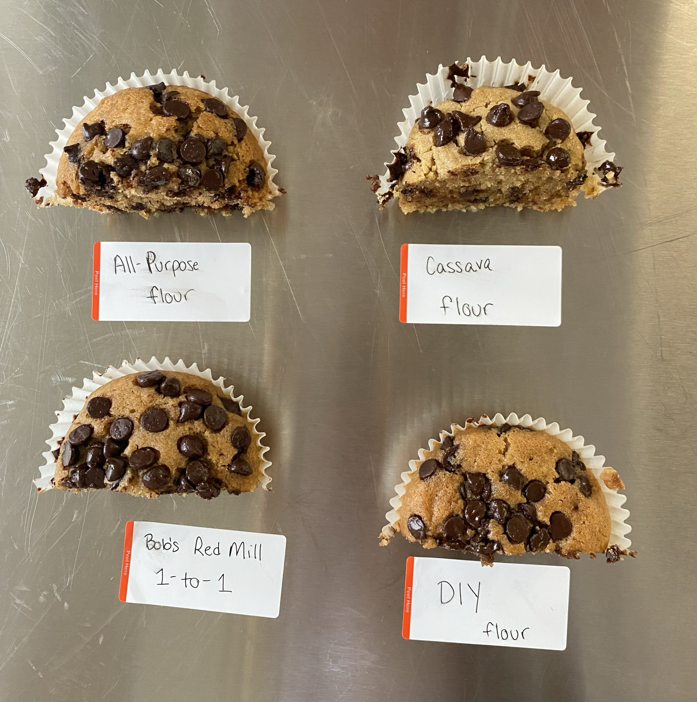
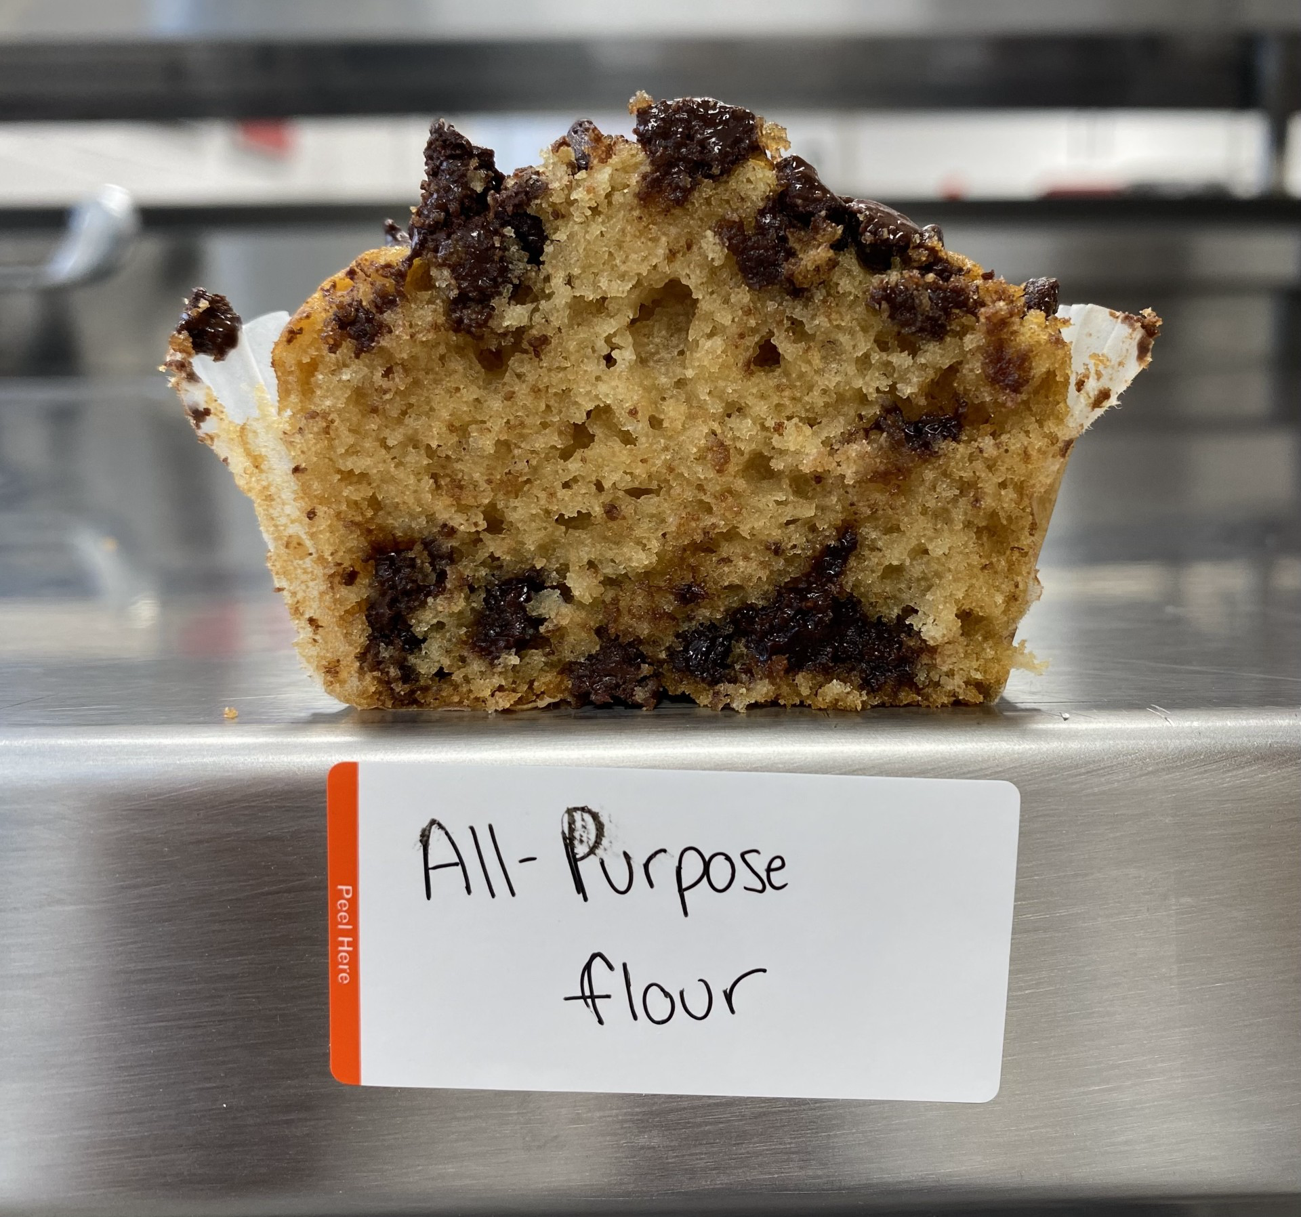
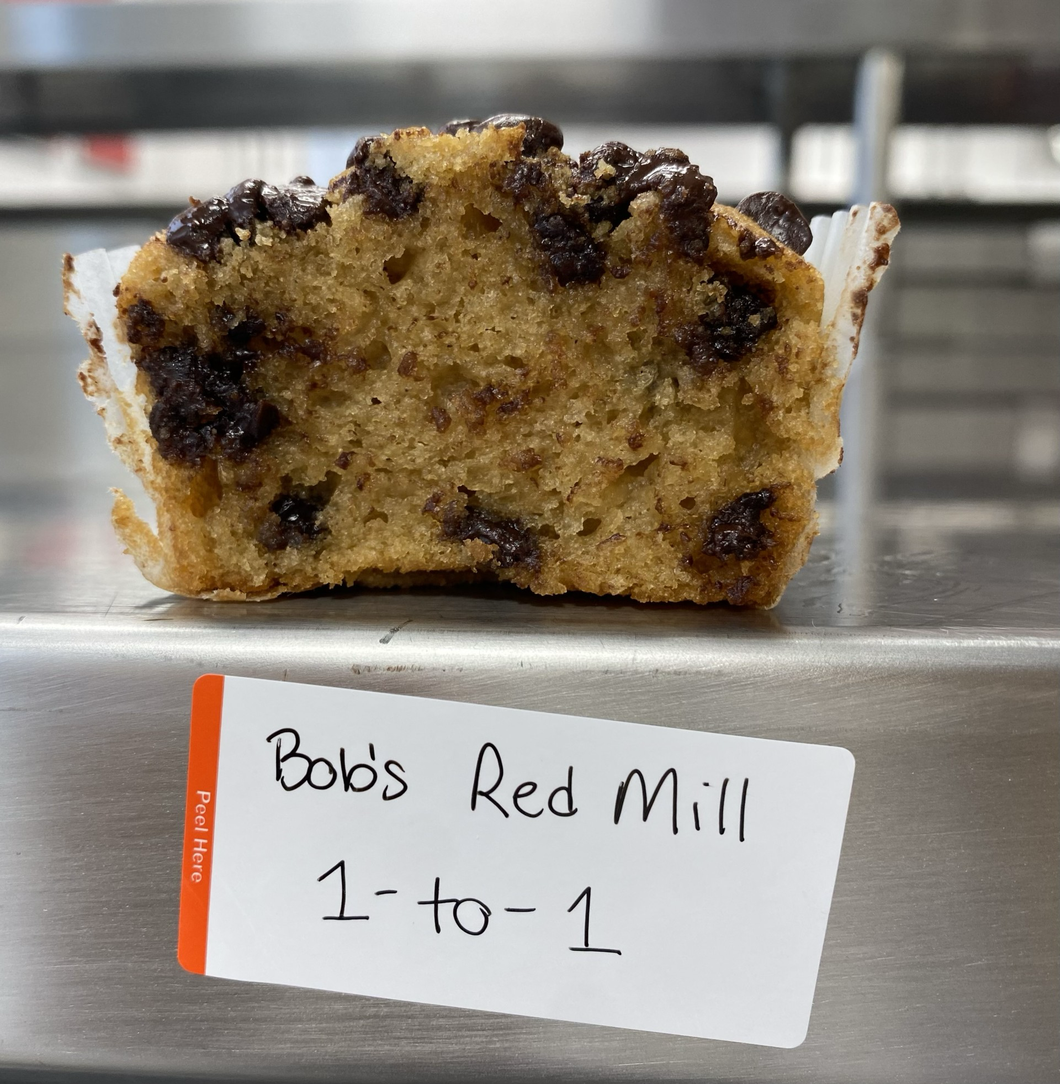
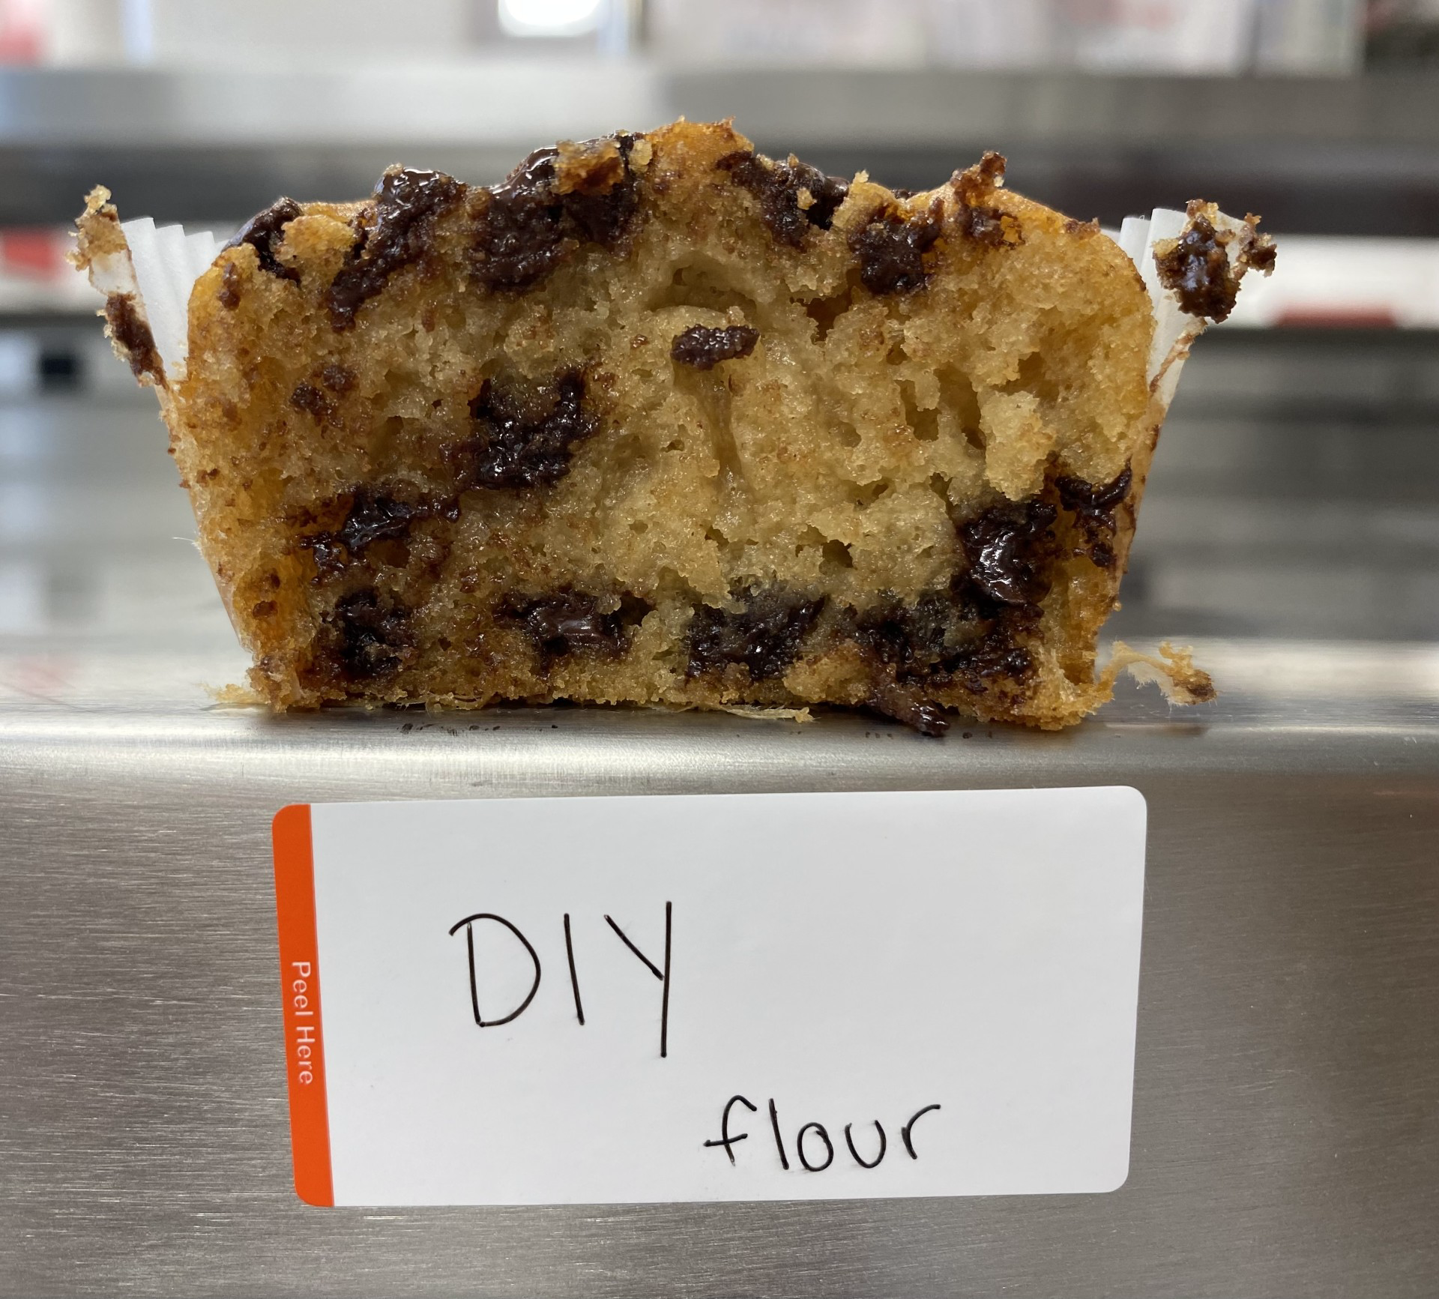
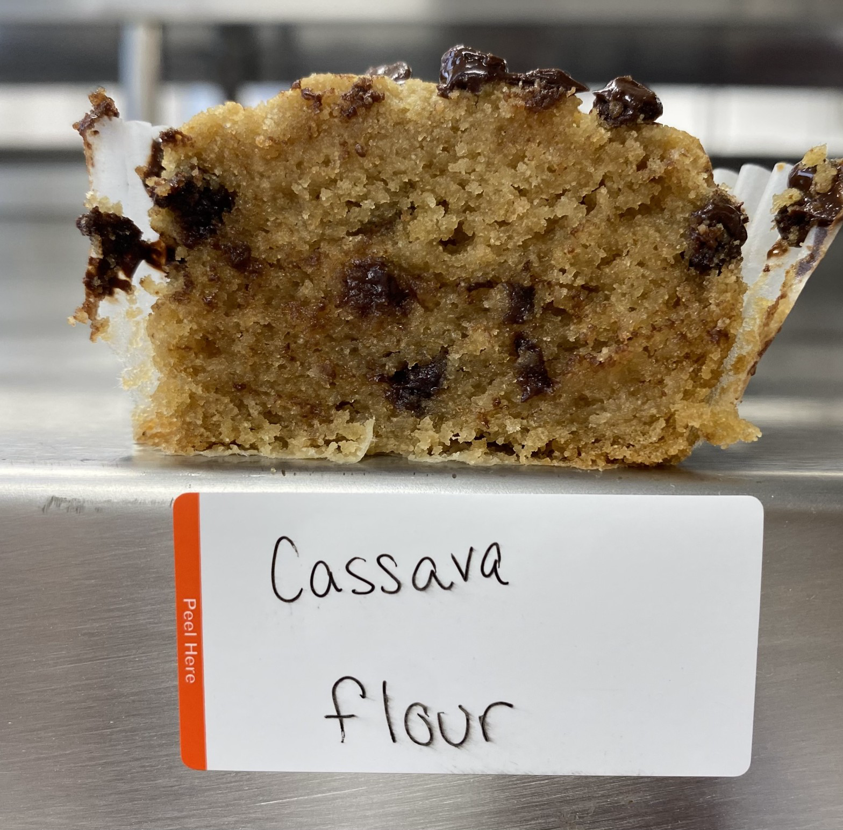
Results

Slide 13
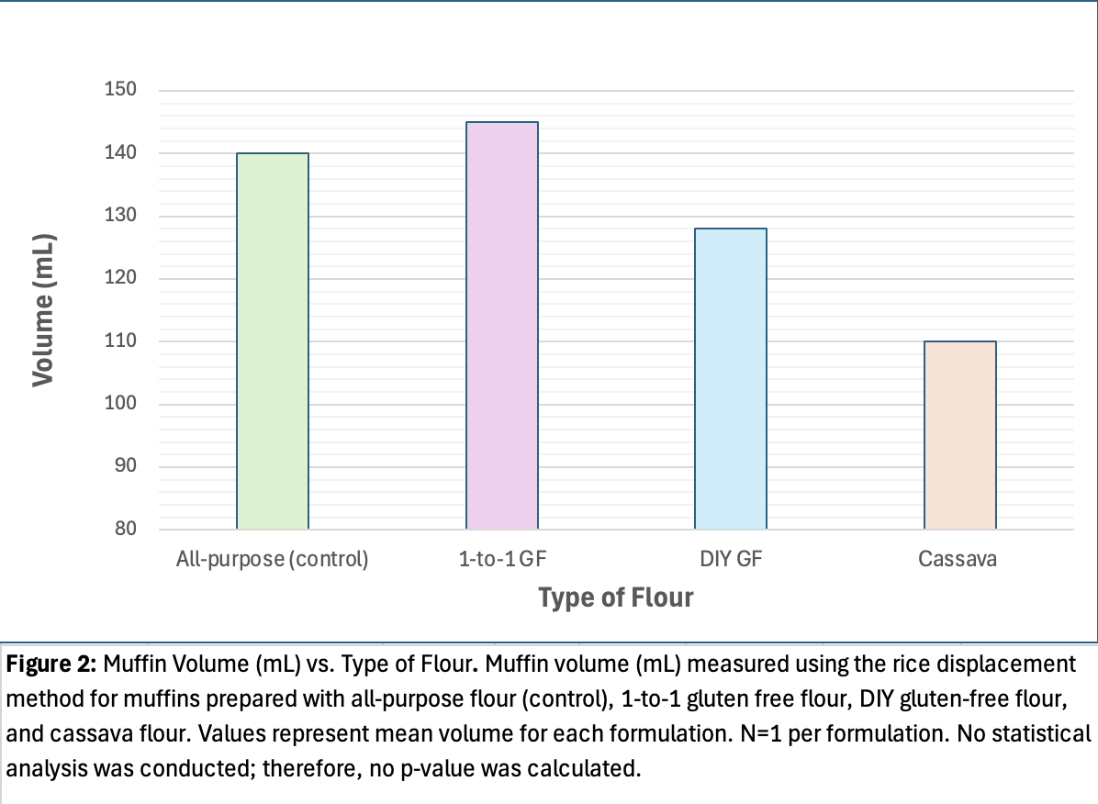
Muffin Volume
1-to-1 Gluten Free : 145 mL
All-purpose: 140 mL
DIY Gluten-Free: 128 mL
Cassava: 110 mL
Observation:
Commercial GF Flour achieved comparable volume to All-Purpose Flour (control)

Slide 14
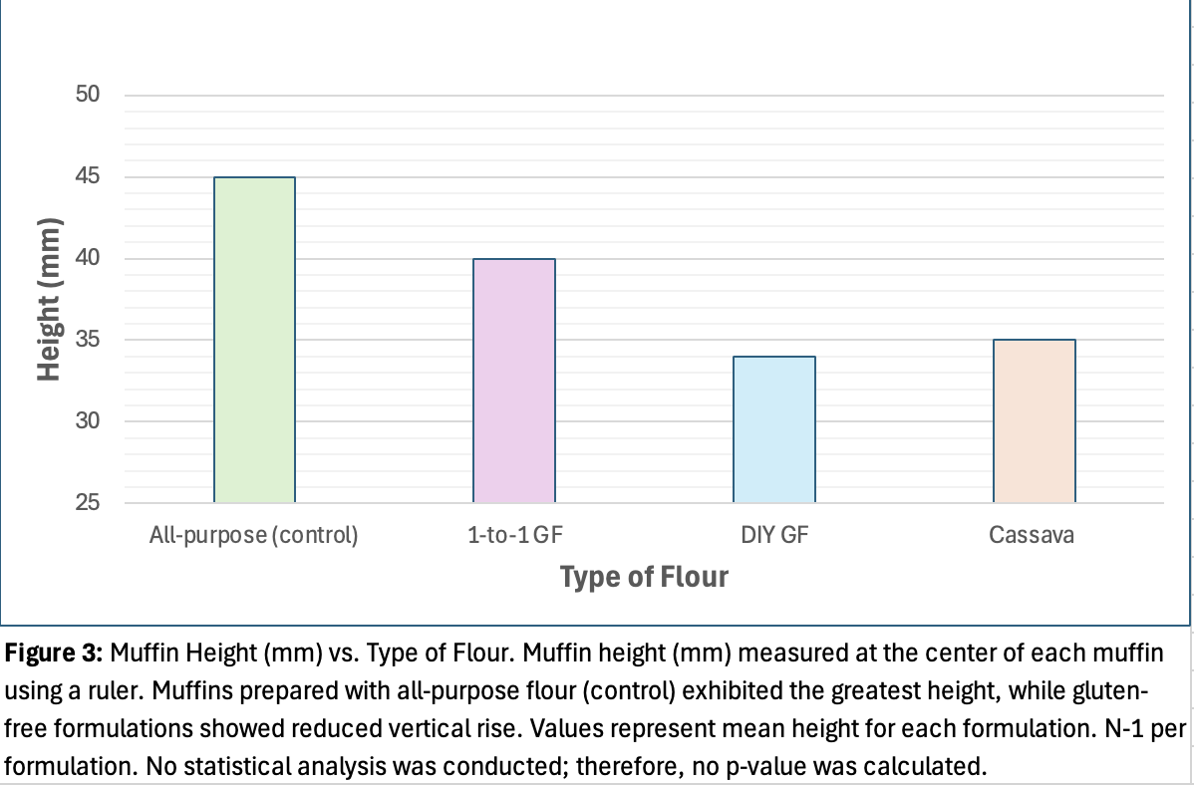
Muffin Height
All-purpose: 45 mm
1-to-1 Gluten Free : 40 mm
Cassava: 35 mm
DIY Gluten-Free: 34 mm
Observation:
Gluten removal reduced vertical rise

Slide 15
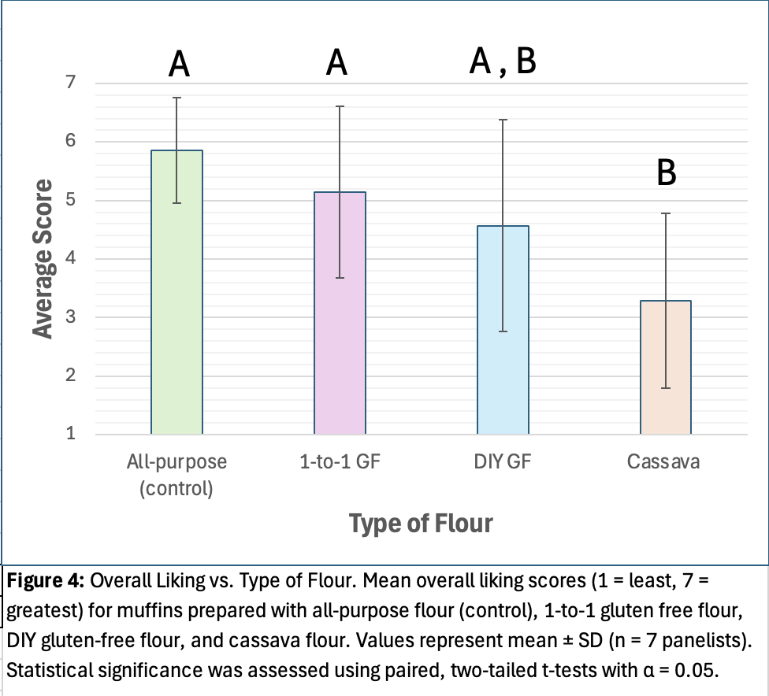
Overall Liking
All-purpose: 5.86 ± 0.90
1-to-1 Gluten Free : 5.14 ± 1.46
DIY Gluten-Free : 4.57 ± 1.81
Cassava: 3.29 ± 1.50
Cassava significantly lower than control and 1-to 1 Gluten Free Flour (p < 0.05)

Slide 16
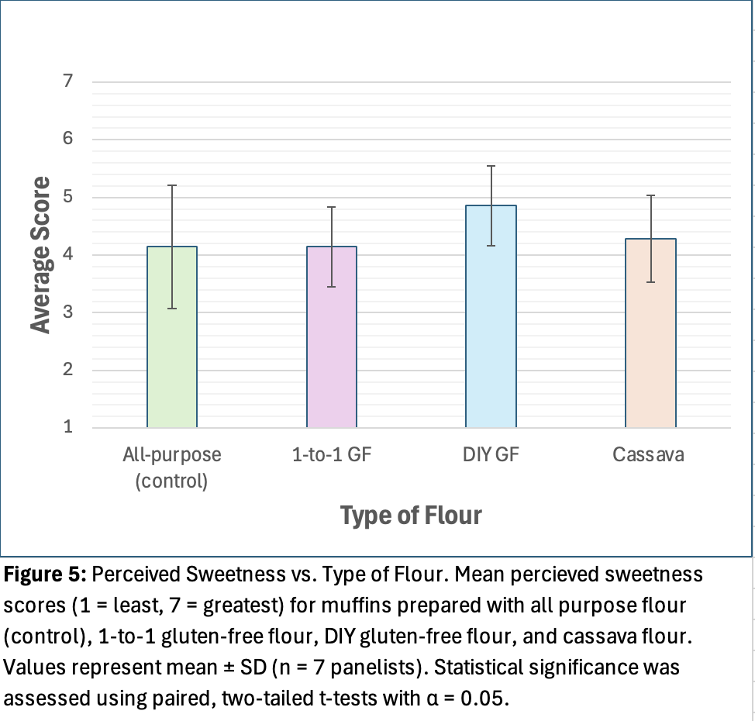
Sweetness
No significant differences (p > 0.05)
Similar sweetness perceptions despite different flours

Slide 17
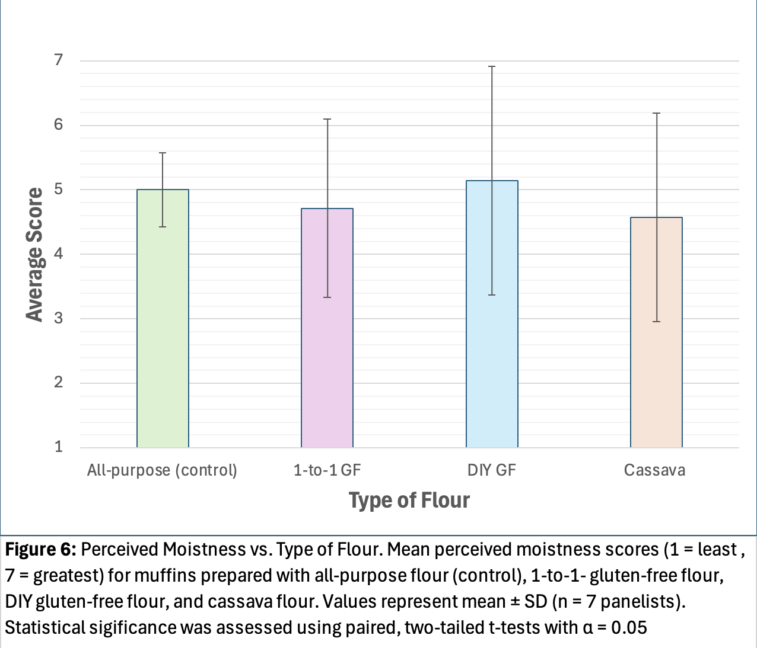
Moistness
DIY Gluten-Free was numerically the highest
No statistically significant differences (p > 0.05)

Slide 18
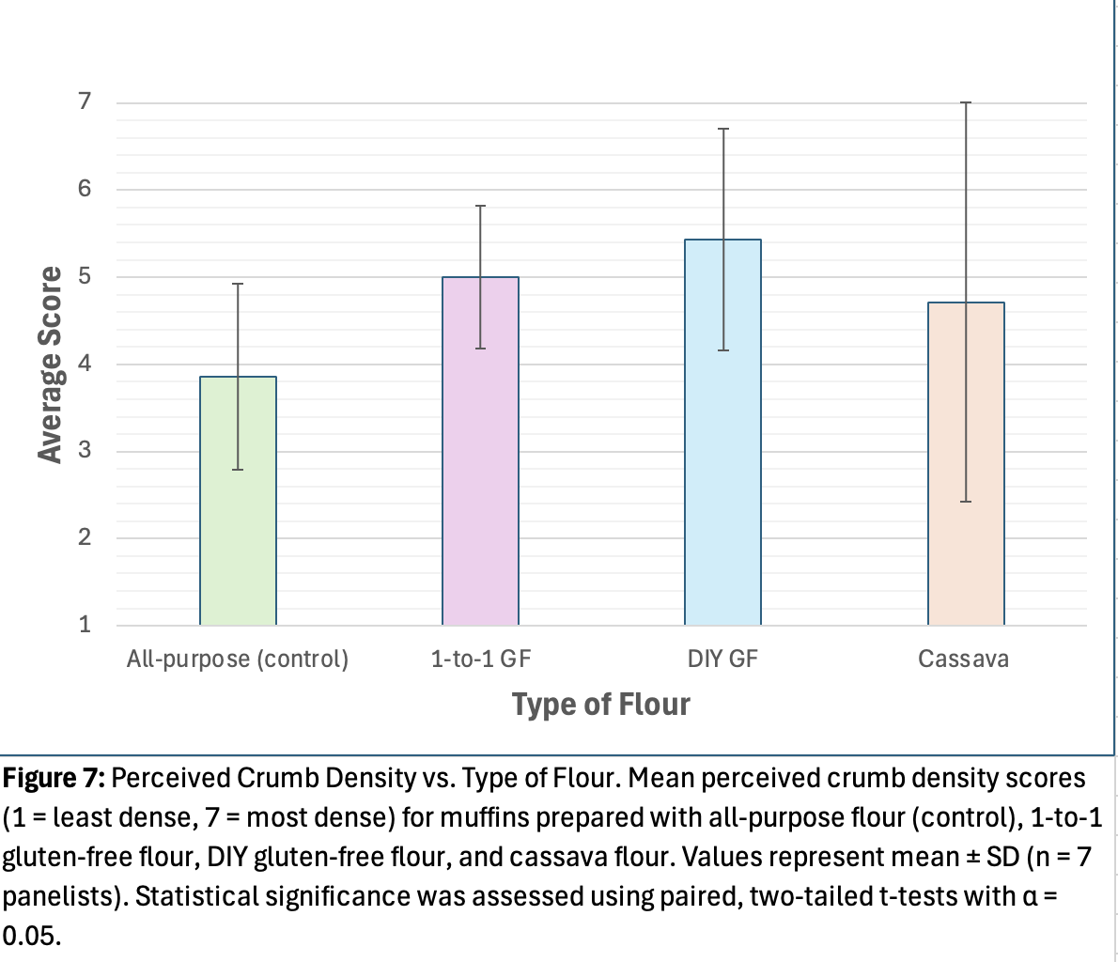
Crumb Density
Gluten-free muffins were perceived as more dense
No statistically significant differences (p > 0.05)

Slide 19

General Comments
All-purpose → fluffy and airy, good interior, good volume
Cassava → tasted earthy, more savory
1-to-1 Gluten-Free → chewy
DIY Gluten-Free → gummy interior, chewy texture, stuck to paper, fell apart in mouth

Slide 20
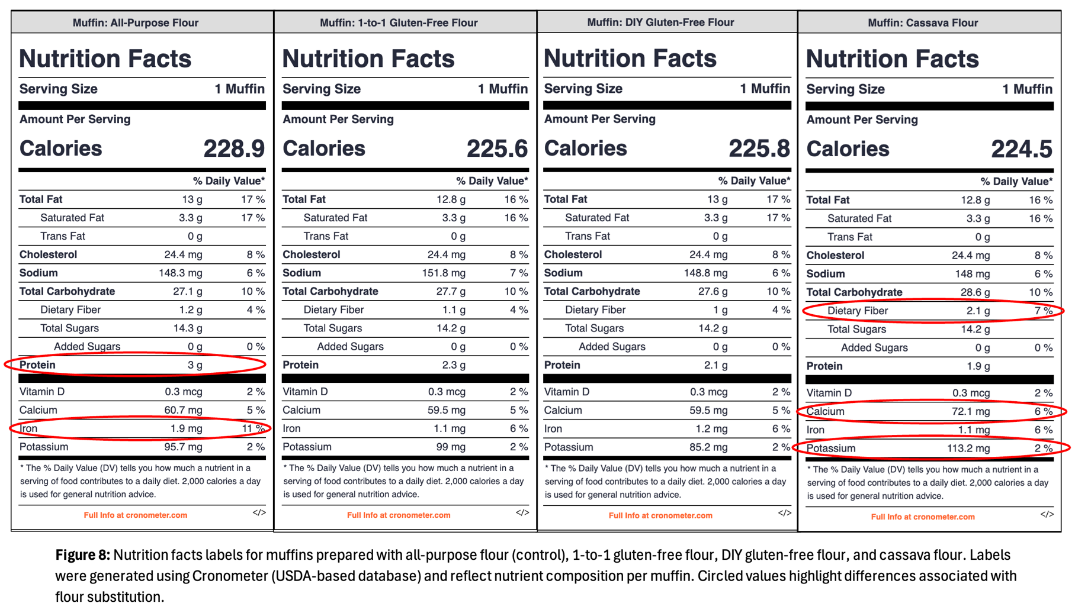
Nutrition Facts Comparison
(Cronometer, n.d.)

Slide 21
Discussion : Hypotheses
Muffins made with gluten-free flours generally had reduced height compared to the all-purpose flour control, supporting the height hypothesis.
The hypothesis that gluten-free muffins would have lower volume was only partially supported, because the commercial 1-to-1 gluten-free flour achieved a volume similarly to the control.
Overall liking differed by flour formulation, with cassava flour muffins rated significantly lower than the control, while other gluten-free formulations were not significantly different.
Flour type did not significantly affect perceived sweetness or moistness, most likely due to the identical sugar and fat content across all formulations.

Slide 22
Functional Properties
All-purpose flour produced taller, less dense muffins because gluten forms an elastic protein network that traps air during baking.
Gluten-free flours lack this protein network and rely primarily on starch for structure, resulting in reduced vertical rise and denser crumb texture.
The commercial 1-to-1 gluten free flour performed most similarly to the all-purpose flour most likely due to the formulation strategies designed to mimic gluten functionality.
Cassava flour increased dietary fiber but negatively affected texture and overall acceptability, demonstrating a trade-off between nutritional value and sensory quality.
Gluten-free flour baking success depends on flour formulation, not necessarily just the removal of gluten.
(Ho et al., 2019; Park & Kim, 2023; Chisenga et al., 2019)

Slide 23
Study Limitations & Future Directions
Limitations
Sensory evaluation conducted with a small, untrained panel
  Increased variability, reduced ability to detect difference
Individual preferences for texture and flavor may have influenced sensory ratings.
Minor variation in mixing, portioning, or baking conditions may have affected final product characteristics despite standardized procedures.
Future Studies:
Increase number of sensory panelists, incorporating trained evaluators
Repeat baking trials to strengthen statistical power.
Use instrumental texture analysis to objectively measure crumb density and elasticity.
Explore binders or thickeners in homemade (DIY) gluten-free formulations to improve structure and sensory quality.

Slide 24
Summary
Flour choice strongly impacts structure and acceptability.
Commercial 1-to-1 gluten free flour performed most similarly to the control.
Cassava flour muffins resulted in improved fiber but reduced overall liking.
This study highlights the difficulty and importance in trying to achieve balance between nutrition and sensory quality of gluten-free goods.

Slide 25
References
Chisenga, S. M., Workneh, T. S., Bultosa, G., & Alimi, B. A. (2019). Progress in research and applications of cassava flour and starch: a review. Journal of food science and technology, 56(6), 2799–2813. https://doi.org/10.1007/s13197-019-03814-6
Celiac Disease Foundation. (n.d.). What is celiac disease? https://celiac.org/about-celiac-disease/what-is-celiac-disease/
Cronometer. (n.d.). Nutrition Analysis Software. https://cronometer.com/
Ho, L., Abidin, Z. N. F. S., Tan, T., & Asyikeen, N. Z. (2019). Physical and sensory qualities of gluten-free muffin produced from composite rice-pumpkin flour. International Food Research Journal, 26(3), 893-901. https://login.proxy.libraries.rutgers.edu/login?qurl=https%3A%2F%2Fwww.proquest.com%2Fscholarly-journals%2Fphysical-sensory-qualities-gluten-free-muffin%2Fdocview%2F2310711910%2Fse-2%3Faccountid%3D13626

Slide 26
References (cont.)
Kowalski, M. K., Domżał-Magrowska, D., & Małecka-Wojciesko, E. (2025a). Celiac Disease—Narrative Review on Progress in Celiac Disease. Foods, 14(6), 959. https://doi.org/10.3390/foods14060959
Kowalski, M. K., Domżał-Magrowska, D., Szcześniak, P., Bulska, M., Orszulak-Michalak, D., & Małecka-Wojciesko, E. (2025b). Gluten-Free Diet Adherence Evaluation in Adults with Long-Standing Celiac Disease. Foods, 14(1), 76. https://doi.org/10.3390/foods14010076
Park, J., & Kim, H. S. (2023). Rice-Based Gluten-Free Foods and Technologies: A Review. Foods (Basel, Switzerland), 12(22), 4110. https://doi.org/10.3390/foods12224110
Sangpueak, R., Saengchan, C., Laemchiab, K., Kiddeejing, D., Siriwong, S., Thumanu, K., Nguyen, H. H., Phansak, P., & Buensanteai, K. (2022). Flour on Gluten-Free Muffins from Different Edible Cassava Varieties in Thailand. Foods, 11(24), 4053. https://doi.org/10.3390/foods11244053

